Slide 1
TechWorkshop L300: Azure AI Apps and Agents
Day 1
Notes:
Speaker notes:
Welcome to the TechWorkshop: Azure AI Apps and Agents
Day 1

Slide 2

Coaches
Coach name here (lead)
Coach [Teams 1 & 2]
Coach [Teams 3 & 4]
Coach [Teams 5 & 6]
Program name – DELETE IF NO PROGRAM
Notes:
Speaker notes:
**Update / Modify this slide with Coach names**​
Channel: General
_________________________________________________________________________________
Speaker notes:
The Lead Coaches will lead all the sessions in this General channel. Later, when we break into assigned teams, each will have an assigned Coach.
Introduce yourself and mention your title and expertise about this topic.​ If there’s more than one Coach, invite the other Coaches to provide a short introduction.

Slide 3
What this workshop includes
This workshop includes:
This workshop does not include:
Hands-on exercise experiences.
x
Shared hands-on exercise environment (such as OpenHack).
Peer-to-peer sharing of proven practice.
A safe place to practice.

Slide 4

Performance criteria
Attendance definition
Be present and accounted for throughout the full workshop.
Missing more than 30 unexcused minutes each day will result in no credit.
Engagement definition
Remain live on video or audio during the day while in attendance (muting is fine).
Participate in discussions and use the chat window.
Completion definition
Complete your exercises for technical proficiency.
Notes:
Speaker notes:
To receive credit, you need to complete each of the listed criteria shown here:
Attendance definition:
Be present and accounted for at all sessions of the training and activities.
An excused absence is allowed for up to 30 minutes each day; however, please aim for an on-time check-in when the training starts.
Engagement definition:
Remain live on camera/audio during the day while in attendance (muting is fine when you are not speaking).
Participate in discussions by asking and answering questions or using the chat window; participate in Break Room solutions.
Do not multi-task or work on unrelated tasks while in attendance.
Completed definition:
Complete through exercise #.
Your Coach will submit your completion to SuccessFactors. You will be notified on the Student Learn site within three days if you successfully completed the workshop.
ASK: Any questions?
Coaches ONLY:
By volunteering for this training, you meet your performance criteria automatically on this topic.

Slide 5

Ask
To have the best experience
Prepare
Engage
Stay
your technology
and actively participate
don’t leave the workshop for more than 30 minutes
Respond
Share
questions
to questions
your experiences
Return
Maximize
Help
on time after each break
your practice time
each session to be successful
Notes:
Speaker notes:
Here are some housekeeping/ground rules:​
First, please silence your phones or other devices.​
Please show your face on camera when working in teams – especially when you are speaking.
If you have bandwidth issues, please let me know (that’s the only exception for being off camera)​. Being on camera especially when asking a question or sharing a point encourages everyone to focus on the speaker and elevates the energy in the session as if in a face-to-face conversation.
Prepare your surroundings so you can focus on the training.​
Actively participate and ask questions.​
Practice inclusivity: Let every voice on your team be heard.​
Mute your microphone when you are not speaking​.
Use your collaboration skills, virtually​.

Slide 6
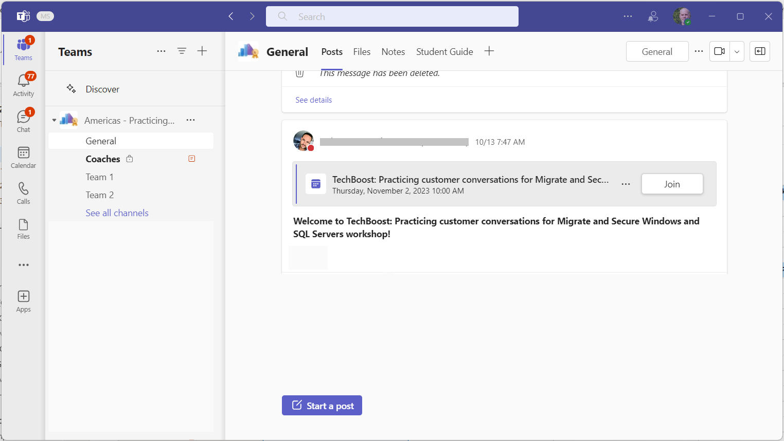
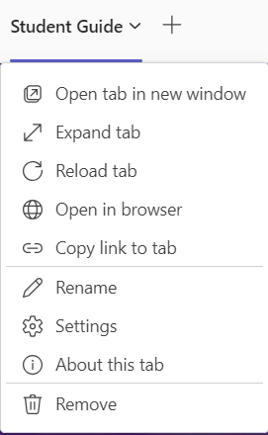
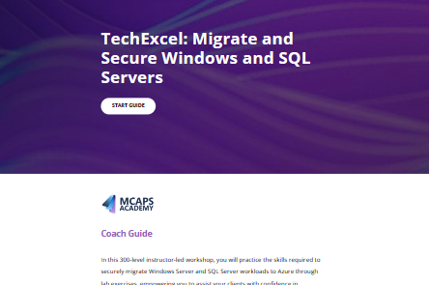
Opening the student guide
Open the guide into the Teams window.
1
2
Open the guide in another tab or in browser.
Notes:
<Coach>
Encourage students to open the participant guide and follow along. They will have access to the same PPT that you are showing.

Slide 7
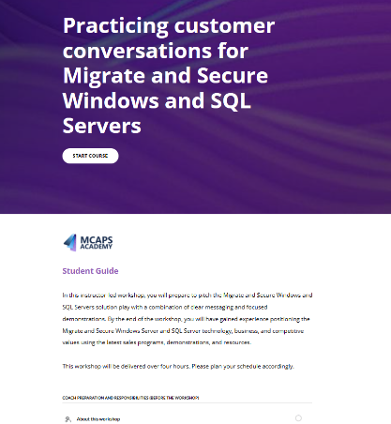

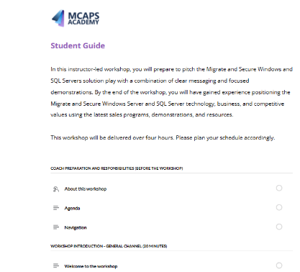
Navigating the student guide
Select "Start Course“ to review the workshop content.
3
4
Module name.
5
Unit content.
Notes:
<Coach>
Encourage students to open the participant guide and follow along.
They will have access to the same PPT that you are showing.

Slide 8
Workshop abstract
In this virtual instructor-led 300-level workshop, you’ll develop the skills to design and deploy agentic AI solutions that enhance customer engagement and streamline development workflows. Using a retail scenario, you’ll explore building impactful, scalable, and responsible agentic AI Solutions for the customers, along with orchestration across multiple agents using Agentic AI frameworks, Models, tools, and integration technologies (MCP, A2A).
Through hands-on labs and discussions, you’ll gain practical experience with Microsoft Foundry and Azure data, apps, and integration services, along with Microsoft Copilot Studio and GitHub, to build secure, scalable, and impactful AI applications.
Notes:
<Coach> Go over the slide information with students.

Slide 9
Learning objectives
At the end of this workshop, you'll be able to:
Envision a technical architecture for agentic AI solutions based on customer needs and AI practices.
Develop secure and scalable AI systems that comply with responsible AI principles and protect sensitive business data.
Apply agentic DevOps practices to accelerate software development and deployment using GitHub Copilot, GitHub Actions, and Azure CI/CD pipelines.
Design, build and debug agentic AI solutions (single agent, multi agent) using Agentic AI frameworks, Models, tools, and integration technologies.
Notes:
<Coach> Review the learning objectives with students.

Slide 10
Workshop agenda day one
Start | Duration | Session | Mode
09:00 | 10 | Welcome and course overview | General
09:10 | 60 | Overview of agentic AI, use cases, Innovate with Azure AI Apps and Agents solution play, and agentic AI solution architecture | General
10:10 | 30 | Intro to case study, envisioning whiteboard, and lab exercises one and two | General
10:40 | 60 | Technical envisioning and architecture whiteboard session | Team
11:40 | 30 | Break
12:10 | 60 | Exercise one: Deploy application resources | Team
13:10 | 60 | Exercise two: Implement a multimodal AI shopping assistant | Team
14:10 | 10 | Debrief on exercises one and two | Team
14:20 | 10 | Day one wrap-up | General
Notes:
Coach> Review the Day 1 agenda with students.

Slide 11
Workshop agenda day two
Start | Duration | Session | Mode
09:00 | 10 | Day two welcome and day one review | General
09:10 | 30 | Challenges and multi-agent orchestration | General
09:40 | 10 | Intro to lab exercises three through six | General
09:50 | 40 | Exercise three: Extend the shopping assistant using the A2A protocol | Team
10:30 | 60 | Exercise four: Observe model utilization in Microsoft Foundry | Team
11:30 | 10 | Debrief on exercises three and four | Team
11:40 | 45 | Break
12:25 | 60 | Exercise five: Agentic DevOps | Team
13:25 | 40 | Exercise six: AI-enhanced red teaming | Team
14:05 | 10 | Debrief on exercises five and six | Team
14:15 | 15 | Course wrap-up | General
Notes:
<Coach> Review the Day 2 agenda with students

Slide 12
Lab outline
DAY ONE
DAY TWO
Exercise one
Exercise three
Extend the shopping assistant using the A2A protocol
Deploy application resources
Exercise four
Observe model utilization in Microsoft Foundry
Exercise two
Implement a multimodal AI shopping assistant
Exercise five
Agentic DevOps
Exercise six
AI-enhanced red teaming
Notes:
<Coach> Review with students the exercises for day one and day two, so students know what to expect:
Day 1 – Title(s) and lab main objective
Day 2 – Title(s) and lab main objective

Slide 13

Resources
Hands-on training opportunities
TechWorkshop L200: AI Apps and Agents (for Cloud and AI Solution Specialists)
TechWorkshop L300: GitHub Copilot and platform
Microsoft resources
L200 Innovate with Azure AI Apps and Agents
Azure Essentials - Innovate with Azure AI Platform - L200 Resource Deck
FY26 Cloud & AI Platform Partner Playbook - INTERNAL - FINAL.pptx
FY26 Solution Play Deep Dive - Innovate with Azure AI Apps and Agents - July 30, 2025.pptx
Gold Standard Accelerators (Stage 1-2 positioning)Azure Hero DREAM Demos- Landing Page
Use Case Specific AI Discovery Questionnaire
AI Agent Orchestration Patterns - Azure Architecture Center | Microsoft Learn
Build a Conversation Knowledge Mining Solution by using Azure AI Services - Azure Architecture Center | Microsoft Learn
Build a Document Generation System by Using AI - Azure Architecture Center | Microsoft Learn
Extract and Map Information from Unstructured Content - Azure Architecture Center | Microsoft Learn
Build a Multiple-Agent Workflow Automation Solution with Semantic Kernel - Azure Architecture Center | Microsoft Learn
Notes:
<Coach> Here are some optional, but highly recommended pre-work and some additional resources.

Slide 14
Agentic AI overview
Innovate with Azure AI Apps and Agents
Notes:
<Coach>
This section sets the foundation for the rest of the workshop and provides an overview of Agentic AI solutions. You’ll start from customer pain points, then introduce the solution at a high-level overview.

Slide 15
Where we are today
Organizations face significant challenges with complex, manual, and time-consuming workflows and minimal automation.
K
Inefficiency and high operational costs
Lack of visibility & control
Human error
Scalability issues
Notes:
Speaker notes:
Let’s start by discussing the current landscape many organizations face when it comes to their business processes and workflows.
Most organizations today are still dealing with complex, manual, and time-consuming workflows. These processes often lack automation, which leads to several critical challenges:
Inefficiency and High Operational Costs: Manual processes are typically slower and more error-prone, leading to inefficiencies and increased operational costs.
Lack of Visibility and Control: Without automation, it’s hard to monitor and manage processes in real time. Leaders often lack the visibility needed to make informed decisions or to quickly identify bottlenecks and issues.
Human Error: When tasks are performed manually, there’s always a risk of mistakes—whether it’s data entry errors or missed steps in a process. These errors can have downstream impacts, sometimes resulting in costly rework or compliance issues.
Scalability Issues: As organizations grow, manual processes become bottlenecks. What worked for a small team quickly becomes unsustainable at scale, limiting the organization’s ability to respond to new opportunities or increased demand.
These challenges highlight why so many organizations are looking to automation and AI-driven solutions. By addressing inefficiency, reducing errors, improving visibility, and enabling scalability, automation can transform how businesses operate.
Source: Azure AI Agent Service L300 Pitch Deck (link not available)

Slide 16
A new frontier:
Agentic AI
Notes:
Speaker notes:
Today, we are exploring an exciting new frontier in AI: Agentic AI. This concept is transforming how we interact with technology. Rather than simply automating tasks, Agentic AI represents intelligent agents that can handle more complex workflows, adapt to changing requirements, and collaborate with humans to achieve better outcomes. These agents are not just rule-based bots. They can reason, plan, and make decisions in real time, responding dynamically to new information and evolving situations. Agentic AI enables systems to move beyond static automation—allowing for more dynamic, efficient, and human-centric solutions. This evolution paves the way for more dynamic and efficient systems, moving beyond the limitations of traditional automation.
Source: Azure AI Agent Service L300 Pitch Deck (link not available)

Slide 17
Why innovate with Azure AI apps and agents
Empower developers to easily build AI apps and agents
Design, customize,
and manage
AI apps and agents at scale
Scale AI apps and agents seamlessly and efficiently
Secure, govern, and ensure the safety of AI
Enable developers with integrated AI-native tools
Reduce developer ramp-up and unlock AI-driven innovation across teams
Orchestrate models, agents, and AI apps through a unified platform
Get end-to-end visibility and centralized resource management across departments
Streamline deployment and scaling of AI services with enterprise-grade databases and app services
Optimize resource utilization, run AI apps with high performance, and align AI scaling with ROI goals
Mitigate risk and ensure security and governance with powerful tools
Empower responsible AI practices with built-in security, governance, and observability
Notes:
Speaker notes:
Why is Azure such a powerful platform for building AI apps and agents?
Azure helps customers easily build, customize, scale, and run AI apps and agents.
It provides low code as well as pro code options for developer tools that enable 20% faster innovation through the use of agentic DevOps.
It provides a comprehensive AI platform with a choice of more than 11,000 foundational, open, as well as industry-specific models that enable customers to design, customize, and manage their AI apps and agents at scale.
It also provides application platform and database services that enable customers to run their apps at hyperscale with high reliability and up to 70% reduced operational overhead.
Finally, it helps customers secure and govern their AI apps and agents to minimize business risk.
By leveraging Azure’s integrated AI-native tools, organizations can reduce developer ramp-up time, accelerate innovation, and unlock new business value. They can scale AI apps and agents seamlessly, optimize resource utilization, and align their AI investments with ROI goals.
Source: L200 Innovate with Azure AI Apps and Agents
https://microsoft.seismic.com/app#/doccenter/a5266a70-9230-4c1e-a553-c5bddcb7a896/doc/%252Fdde0caec0e-9236-f21b-2991-5868e63d3984%252FdfYTZjNDRiZDMtMzEwZS1kNWZkLTNjOGEtNjliYWJjMjhmMmUw%252CPT0%253D%252CUHJvZHVjdCBQaXRjaCBEZWNr%252Flfa743e174-a9d2-47bb-b0ea-6502a0b8438c//?mode=view

Slide 18
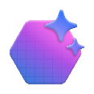






What is an AI agent?
Agent
3
1
Input
Output
LLM
+
Instructions
User messages
Agent messages
+
Agent messages
Tool results
System events
Tools
2
Tool calls
An AI agent is a micro-service that takes unstructured messages, optionally invokes other APIs, and returns messages.
1
2
3
Knowledge
Actions
Memory
Notes:
Speaker notes:
Let’s break down what we mean by an AI agent and how it differs from traditional automation or simple bots.
An AI agent is a micro-service that takes unstructured messages—like user questions or system events—optionally invokes other APIs or tools and returns meaningful responses.
Agents are powered by large language models (LLMs) and can follow instructions, use tools, access knowledge, perform actions, and retain memory of previous interactions.
The agent workflow typically involves three main steps:
Input: The agent receives messages from users or systems.
Processing: The agent interprets the input, may call tools or APIs, and uses its memory and knowledge to reason and plan.
Output: The agent generates a response, which could be a message, an action, or a result from a tool.
Unlike rule-based bots, AI agents can handle more complex, iterative tasks, adapt to new information, and collaborate with other agents or humans.
Why This Matters: This architecture allows agents to solve a wide range of problems—from answering questions and retrieving data to executing multi-step workflows and integrating with external systems. Also, agents can be designed for specific roles, such as coding, analytics, customer support, or orchestration, and can work together in multi-agent systems for even more complex scenarios.
Next, we’ll look at the spectrum of LLM-based solutions, from simple one-shot tasks to sophisticated multi-agent systems.
Source: Azure AI Agent Service L300 Pitch Deck (link not available)

Slide 19








Spectrum of LLM-based solutions
Memory
history of work
User Proxy Agent
Coordinator Agent
LLM
Agent
LLM
conversation
LLM
question
query
data
prompt +
data
prompt
answer
Service
Agent
LLM
Retrieval
Agent
LLM
Analytics
Agent
S
LM
Coding
Agent
SLM
document
summary
Search
docs
input
output
query
data
data
Web Service
Search
databases
docker
docs
No agent
Very narrow one-shot task
Example: log to JSON
Single agent
Very clearly scoped iterative task
Example: provide an answer with supporting evidence to a complex question.
Multi-agent systems
Wide scope complex use case requiring diverse skills
Example: propose two Instagram marketing campaigns including assets that would leverage the top two recent trends in our past quarter US Sales to boost our mailing list user base and predict the impact of each campaign.
VALUE
Notes:
Speaker notes:
At one end of the spectrum, we have no-agent solutions—these are very narrow, single-task applications, like using an LLM to summarize a document or answer a straightforward question. These are quick and efficient but limited in scope. Moving up, we encounter single-agent solutions. Here, an agent can handle iterative tasks, such as answering complex questions with supporting evidence, or retrieving and analyzing data. These agents can interact with users, maintain context, and perform more advanced reasoning. At the most advanced end, we have multi-agent systems. These are designed for wide-scope, complex use cases that require diverse skills. For example, you might have a system that proposes marketing campaigns by analyzing sales trends, generating creative assets, and predicting outcomes—all coordinated by multiple specialized agents working together.
As AI systems evolve, we're moving from narrow, single-task solutions to more expansive, iterative systems. Now, we're seeing a more sophisticated architecture, where agents can handle more complex tasks by integrating multiple data sources and interacting with humans to refine outcomes. From single-agent solutions to multi-agent systems, we’re unlocking the potential for AI to solve larger, more complicated problems.
Key Technical Enablers
Human level reasoning capabilities
Enables critical thinking, re-planning to establish resolution strategies and incorporate human in the loop.
Larger context windows
Enables reasoning over execution history to re-plan + integrate feedback from multiple agents.
SLM for specialized agents
Enables rapid execution to keep human engaged in the loop and enables cost effective resolution.
Multi-modality support
Widens scope of use-cases and eases access to Agentic AI Systems.
Source: Azure AI Agent Service L300 Pitch Deck (link not available)

Slide 20




Agentic AI capabilities
Web Search
Memory
Self-critique
Code Execution
Subgoal decomposition
Tools
Agent
Planning
Calculator
Collaboration
Calendar
...many more design patterns
ReAct
Action
...more
Notes:
Speaker notes:
Agentic AI is powered by several key capabilities that make it far more dynamic and versatile than traditional systems:
Planning: Agents can create and adjust plans in real time, responding to new information and changing requirements.
Memory: Agents retain context from previous interactions, allowing them to build on past conversations and actions.
Tools: Agents can use a variety of tools—such as web search, code execution, calculators, calendars, and more—to solve problems and perform tasks.
Action: Agents can take actions based on their reasoning, not just provide information.
Collaboration: Agents can work together or with humans, sharing information and coordinating tasks.
Subgoal Decomposition: Agents can break down complex problems into manageable subgoals and tackle them step by step.
Self-critique and ReAct: Agents can evaluate their own performance and refine their approach, leading to better outcomes.
These capabilities allow agentic AI systems to handle a wide range of use cases—from answering questions and retrieving data, to executing multi-step workflows and integrating with external systems. For example, agents can use tools like web search, code execution, and even calendars, while retaining memory of past interactions to inform decisions. The ability to plan, act, and react in real-time allows these agents to provide adaptive solutions for a variety of use cases.
Source: Azure AI Agent Service L300 Pitch Deck (link not available)

Slide 21






Responsible AI principles at Microsoft
Taking a principled and human-centered approach to our investments in AI
As we design, build, and release AI products, these six principles remain our foundation and guide our work every day.
Learn more about our approach:
Putting responsible AI principles into practice begins with our Responsible AI Standard, a living document that details how to integrate responsible AI into engineering teams, the AI development lifecycle, and tooling.
Our Responsible AI Transparency Report describes how we build generative AI applications responsibly, make decisions about releasing generative AI applications, and support you as you build your own generative AI apps.
Governing AI: A Blueprint for the Future outlines our recommendations for the public governance of AI.
Fairness
AI systems should treat all people fairly.
Reliability and safety
AI systems should perform reliably and safely.
Privacy and security
AI systems should be secure and respect privacy.
Inclusiveness
AI systems should empower everyone and engage people.
Transparency
AI systems should be understandable.
Accountability
People should be accountable for AI systems.
Notes:
Speaker notes:
At Microsoft, we believe that when you create technologies that can change the world, you must also ensure that the technology is used responsibly.
It all starts with our AI principles.
Our Fairness principle speaks to how AI allocates opportunities, resources, or information in ways that are fair to the humans who use it.
Reliability and Safety and Privacy and Security ensure we’re considering how the system functions well for people across different use conditions and contexts, including ones it was not originally intended for, and how we safeguard information.
Inclusiveness looks at how the system should be designed to be inclusive of people of all abilities.
Lastly, are our foundational principles of Transparency and Accountability. These account for how people could misunderstand, misuse, or incorrectly estimate the capabilities of the system, while creating the necessary oversight so that humans can be accountable and in control with these systems.
These 6 principles that have not changed since Microsoft first adopted them in 2018 – they continue to be durable, even as AI technologies evolve.
Because principles are not self-executing, we developed a Responsible AI Standard to help us move from theory into practice by outlining the specific goals, requirements and practices that our engineering teams need to follow.
You can also learn more about our internal governance approach through our inaugural Responsible AI Transparency Report and our Five-Point Blueprint for Governing AI.
Source: Azure Essentials (L200) - Innovate with Azure AI Platform Pitch Deck
https://microsoft.seismic.com/app#/doccenter/a5266a70-9230-4c1e-a553-c5bddcb7a896/doc/%252Fdde0caec0e-9236-f21b-2991-5868e63d3984%252FdfYTZjNDRiZDMtMzEwZS1kNWZkLTNjOGEtNjliYWJjMjhmMmUw%252CPT0%253D%252CU2FsZXMgR3VpZGFuY2UvU2FsZXMgR3VpZGU%253D%252Flf34b7cb30-316b-4a1e-9174-183d2d1f1a1c//?mode=view

Slide 22
A developer-first AI platform
Accelerate innovation, scale AI initiatives efficiently, and reduce dependence on specialized talent—unlocking faster time-to-value and competitive advantage
Evolve developer experience from AI-infused to AI-native
Increase developer productivity with AI extended across the software lifecycle
Accelerate delivery of AI apps and agents
55% faster task completion
42% more productive developers
20% faster innovation
Notes:
Speaker notes:
The road to Agentic DevOps began several years ago with our earliest iterations of GitHub Copilot.
Developers are the architects of this new era, crafting the applications and systems that harness the power of AI to solve real-world problems.
At Microsoft, we believe this transformation will happen across three core areas.
First, the value that we have seen from AI-assisted tooling is just the beginning. We are moving from a point of helping traditional processes and tools be more efficient through AI, to solutions that are built natively with AI, redefining developer practices.
Second, the value of AI, which has been focused primarily on coding, code assistance, and productivity in one phase of the software lifecycle will extend across the entire SDLC to help every team uplevel and implement the promises of DevOps.
And last, we believe that as developer platforms and AI platforms become ubiquitous across teams, we will see AI and agentic applications will become the norm for every application.
Source: L200 Innovate with Azure AI Apps and Agents
https://microsoft.seismic.com/app#/doccenter/a5266a70-9230-4c1e-a553-c5bddcb7a896/doc/%252Fdde0caec0e-9236-f21b-2991-5868e63d3984%252FdfYTZjNDRiZDMtMzEwZS1kNWZkLTNjOGEtNjliYWJjMjhmMmUw%252CPT0%253D%252CUHJvZHVjdCBQaXRjaCBEZWNr%252Flfa743e174-a9d2-47bb-b0ea-6502a0b8438c//?mode=view

Slide 23



Agentic DevOps
AI-powered agents operating as a member of your dev team—automating, optimizing, and accelerating every stage of the software lifecycle
GitHub Copilot
SRE Agent
GitHub Models
Agent Mode
Coding Agent
App Modernization
AI-powered operator, continuously monitoring and optimizing apps in production
Every developer can be an AI developer with full model accessibility and fine-tuning in GitHub to speed app development
AI-powered pair programmer, performing multi-step tasks at the developer’s command
AI-powered peer programmer, automating routine tasks and jobs to be done across the software lifecycle
GitHub Copilot extends AI-assisted capabilities to accelerate modernization and upgrades for .NET and Java apps
Public Preview
Public Preview
Public Preview
Notes:
Speaker notes:
We are continuing to build out GitHub Copilot specifically to support the developer experience. Our goal is for GitHub Copilot to help automate the mundane so developers can feel empowered to focus on what matters.
Indeed, GitHub Copilot serves as the foundation supporting our vision for agentic DevOps, and together with tools like GitHub Models and the Site Reliability Engineering Agent in Azure, we are well on the way to empowering developer teams to adopt agentic DevOps.
During early stages, GitHub Models integrates with GitHub to provide developers with an easy to navigate environment for testing, evaluating, and fine-tuning AI apps and their underlying models, while GitHub Spark provides an AI-native, natural language experience that helps devs prototype by rapidly transforming ideas into deployed apps.
Throughout development, new tools in GitHub Copilot like Agent Mode, Software Engineering Agent, and App modernization agent expand the capabilities available to devs to support multi-step processes throughout development—empowering them to hand off routine tasks around everything from coding, reviewing, and testing, to writing documentation and modernizing their apps—and focus on more high-value, creative work.
And at the far end of the software lifecycle, the Site Reliability Engineering agent in Azure supports engineers deploying, operating, and maintaining applications in production.
Source: L200 Innovate with Azure AI Apps and Agents
https://microsoft.seismic.com/app#/doccenter/a5266a70-9230-4c1e-a553-c5bddcb7a896/doc/%252Fdde0caec0e-9236-f21b-2991-5868e63d3984%252FdfYTZjNDRiZDMtMzEwZS1kNWZkLTNjOGEtNjliYWJjMjhmMmUw%252CPT0%253D%252CUHJvZHVjdCBQaXRjaCBEZWNr%252Flfa743e174-a9d2-47bb-b0ea-6502a0b8438c//?mode=view

Slide 24
Where agents are used today
Customer use cases
Notes:
<Coach> While presenting the slides in this section, don’t dive too deep into the architecture. Instead, keep the spotlight on the broad applicability of the use cases and how agentic AI solutions can effectively address diverse business challenges across multiple industries

Slide 25
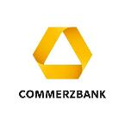


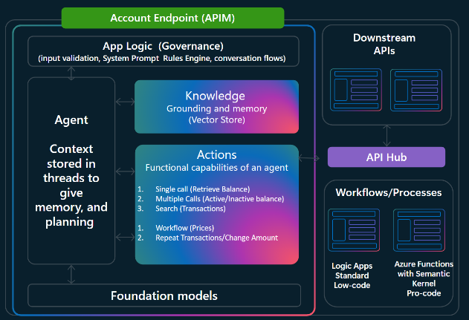

Agent use case #1
Customer support and engagement
Customer story
Customer
Thought
Commerzbank developed a banking avatar that allows customers to get the questions answered in natural spoken language.
The avatar can provide information about the customer’s banking products and enables the digital execution unblocking a current credit card or changing limits.
Planner agent
Plan
Orchestration
Action
Observation
Scanning agent
Transfer tool
Risk agent
Scans images for identity and billing confirmation
Performs account transfers with function calling
Analyzes historical online conversation for risk assessment and mitigation
Notes:
Speaker notes:
Let’s look at a practical example of how agentic AI can transform customer support and engagement.
"In this scenario, we see multiple specialized agents working together to deliver a seamless customer experience:
Planner Agent: Orchestrates the overall customer interaction, planning the flow and coordinating other agents.
Scanning Agent: Handles tasks like scanning images for identity and billing confirmation, automating verification steps.
Transfer Tool: Executes account transfers securely using function calling, reducing manual intervention.
Risk Agent: Analyzes historical online conversations to assess and mitigate risks. This helps prevent fraud or compliance issues.
This orchestration of agents allows for efficient, accurate, and personalized customer support. Customers can get answers to their questions, resolve issues, and complete transactions—all through natural language interactions.
Commerzbank developed a banking avatar that allows customers to get their questions answered in natural spoken language. The avatar provides information about banking products and enables digital execution of tasks like unblocking a credit card or changing limits—all powered by agentic AI
Source: Azure AI Agent Service L300 Pitch Deck (link not available)

Slide 26

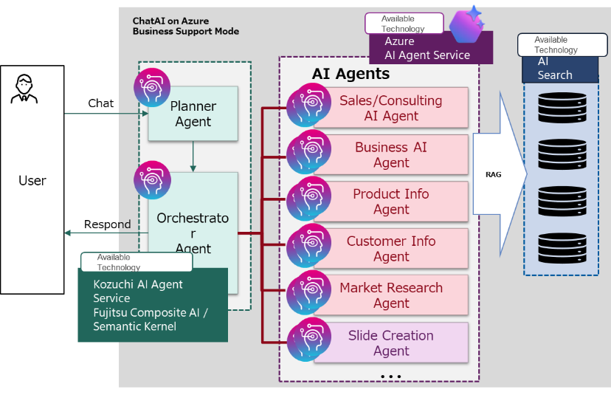



Agent use case #2
Sales and marketing support agent
Customer story
Thought
Fujitsu developed an AI agent, designed to incorporate the expertise of top sales professionals. It helps sellers prioritize customer leads, focus their efforts effectively, and craft personalized proposals tailored to each lead’s specific needs. Their AI Agent drove a 67% increase in productivity for sales proposal creation.
User
Planner agent
Plan
Orchestration
Action
Observation
Data analysis agent
Market research agent
Slide creation agent
Analyzes customer and sales performance data to identify trends and actionable insights
Gathers competitive intelligence and market signals to tailor proposals to buyer needs
Automatically generates polished sales proposal slides using data and context provided by other agents
Notes:
Speaker notes:
Let’s explore how agentic AI can transform sales and marketing activities by automating and enhancing key processes.
In this scenario, multiple specialized agents collaborate to support sales and marketing teams:
Planner Agent: Orchestrates the workflow, coordinating other agents and planning the overall sales or marketing process.
Data Analysis Agent: Analyzes customer and sales performance data to identify trends and actionable insights. This helps teams focus their efforts where it matters most.
Market Research Agent: Gathers competitive intelligence and market signals, tailoring proposals and campaigns to buyer needs.
Slide Creation Agent: Automatically generates polished sales proposal slides using data and context provided by other agents, saving time and ensuring consistency.
This multi-agent approach streamlines the creation of personalized proposals, improves lead prioritization, and enables teams to respond quickly to market changes.
Fujitsu developed an AI agent that incorporates the expertise of top sales professionals. It helps sellers prioritize leads, focus their efforts, and craft personalized proposals. Their AI agent drove a 67% increase in productivity for sales proposal creation.
Source: Azure AI Agent Service L300 Pitch Deck (link not available)

Slide 27

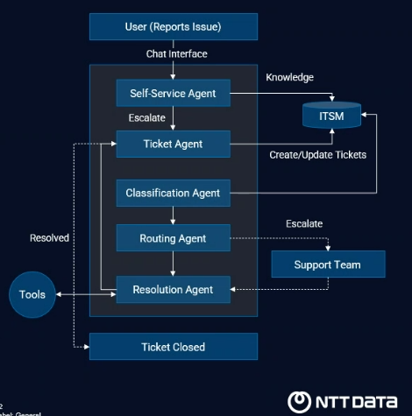

Agent use case #3
Internal IT ticket management
Customer story
User
NTT Data uses a multi-agent system to automate internal IT ticketing. Agents handle self-service, ticket creation, classification, routing, and resolution—integrating with ITSM and escalating to support teams when needed. This streamlines issue resolution and reduces manual workload.
Reports technical issues
Support agent
Forwards the request to Ticket Creation Agent
Ticket Creation agent
Creates a ticket
Classification agent
Analyzes and classified tickets by issue type
Tools
Routing agent
Support Team
Notes:
Speaker notes:
Let’s look at how agentic AI can streamline internal IT support and ticket management, a common challenge for many organizations.
In this scenario, multiple specialized agents work together to automate and optimize the IT ticketing process:
Support Agent: Receives technical issues from users and forwards requests to the Ticket Creation Agent.
Ticket Creation Agent: Automatically creates tickets based on user input, reducing manual effort and speeding up response times.
Classification Agent: Analyzes and classifies tickets by issue type, ensuring that each ticket is routed to the right team or resource.
Routing Agent: Directs tickets to the appropriate support team or escalates them as needed.
Resolution Agent: Assists with resolving tickets, integrating with ITSM systems and using tools for knowledge and troubleshooting.
This multi-agent approach enables self-service, automates ticket creation and classification, and ensures efficient routing and resolution. It reduces manual workload for IT teams and improves the speed and accuracy of support.
NTT Data uses a multi-agent system to automate internal IT ticketing. Agents handle self-service, ticket creation, classification, routing, and resolution—integrating with ITSM and escalating to support teams when needed. This streamlines issue resolution and reduces manual workload.
Source: Azure AI Agent Service L300 Pitch Deck (link not available)

Slide 28

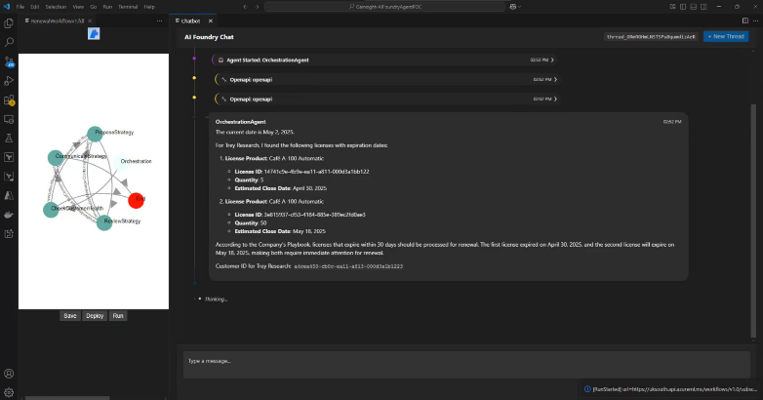
Agent use case #4
Multi-agent renewal automation
Customer story
Strategy agent
Insight agent
Gainsight developed a multi-agent solution that involves several agents working together to manage customer license renewals. The orchestration agent initiates the process, followed by the insight agent assessing the client’s renewal likelihood by connecting to Dynamics 365, and the strategy agent creating a renewal plan. Finally, the supervisor and communication agent ensure compliance and send the renewal email.
User
Supervisor agent
Communication agent
Compliance agent
Agents coordinate to assess renewal risk, generate strategies, ensure compliance, and automate customer communications—streamlining the entire license renewal process.
Notes:
Speaker notes:
Let’s look at how agentic AI can automate and streamline complex business processes, such as customer license renewals.
In this scenario, several specialized agents work together to manage the entire renewal process:
Insight Agent: Assesses renewal risk by connecting to business data and analyzing client likelihood to renew.
Strategy Agent: Generates renewal strategies tailored to each customer’s situation.
Supervisor Agent: Oversees the process, ensuring compliance and proper execution.
Compliance Agent: Checks that all renewal actions meet regulatory and business requirements.
Communication Agent: Automates customer communications, sending renewal notifications and updates.
These agents coordinate to assess renewal risk, generate strategies, ensure compliance, and automate customer communications—streamlining the entire license renewal process.
Gainsight developed a multi-agent solution that orchestrates renewal management. The orchestration agent initiates the process, the insight agent assesses renewal likelihood by connecting to Dynamics 365, and the strategy agent creates a renewal plan. Supervisor and communication agents ensure compliance and send renewal emails—all working together to automate and optimize the process.
Source: Azure AI Agent Service L300 Pitch Deck (link not available)

Slide 29

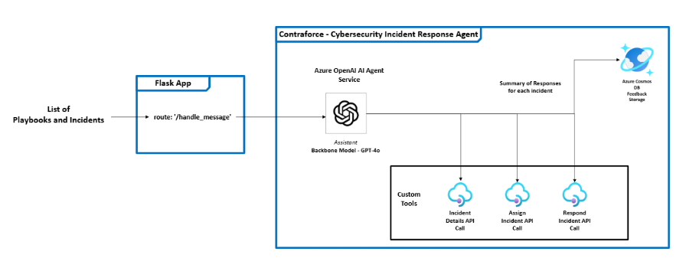

Agent use case #5
AI-Driven security automation
Customer story
Incident API tool
Customer
ContraForce built an AI-powered Agentic Security Delivery Platform (ASDP) using Azure AI Agent Service to help security service providers automate multi-tenant operations and scale incident response. Their first agent, an AI-driven managed detection and response (MDR) agent, filters false positives, executes responses, and preserves institutional knowledge—80% of repetitive triage tasks automated, freeing analysts to focus on high-impact work.
MDR agent
Impact mapping tool
Azure AI Agent Service
Response tool
The MDR agent coordinates multiple tools to automate incident detection, impact analysis, and response actions—filtering false positives, mapping impacted entities, and executing playbooks at scale.
Notes:
Speaker notes:
Let’s explore how agentic AI can transform security operations by automating incident detection, analysis, and response.
In this scenario, specialized agents and tools work together to deliver robust, scalable security automation:
MDR Agent (Managed Detection and Response): Coordinates multiple tools to automate incident detection, affect analysis, and response actions.
Incident API Tool: Integrates with external systems to gather incident details and trigger appropriate responses.
Impact Mapping Tool: Maps impacted entities and helps prioritize response actions.
Response Tool: Executes playbooks and automates remediation steps at scale.
The MDR agent filters false positives, maps impacted entities, and executes response playbooks, preserving institutional knowledge and freeing up analysts to focus on high-impact work.
ContraForce built an AI-powered Agentic Security Delivery Platform using Azure AI Agent Service. Their MDR agent automates multitenant operations and scales incident response, automating up to 80% of repetitive triage tasks and allowing security analysts to focus on strategic threats.
Source: Azure AI Agent Service L300 Pitch Deck (link not available)

Slide 30
Agentic AI discussion
What are some key business challenges your customers face that could be addressed with agentic AI solutions?
How do you see agentic AI transforming customer engagement or development workflows?
What are some common misconceptions customers have regarding agentic AI solutions (and how do you address them)?
Notes:
<Coach> Invite participants to come off mute or share in chat their answers to the questions on this slide.

Slide 31
Innovate with Azure AI Apps and Agents solution play overview

Slide 32
Win Formula: Innovate with Azure AI Apps and Agents
Customer outcome
Accelerate your innovation with differentiated AI—enriching employee experiences and reimagining customer engagement, powered by Microsoft Cloud and partners.
Partner outcome
Help drive revenue growth, profitability, and margins by enriching your services with differentiated AI solutions—supported by Microsoft’s end-to-end engagement model.
Differentiated partner capabilities
Lead with AI innovation and Responsible AI to engage with customers across their business and IT functions
Align customer goals to AI use cases and deploy repeatable solutions with security foundations
Accelerate adoption among end users and developers with emphasis on AI and Security capabilities
Win Formula aligning to MCEM
Listen & consult
Inspire & design
Empower & achieve
Realize value
Manage & optimize
1
2
3
4
5
Build Pipeline
Leverage Partner Core BOM to land AI Envisioning and Value
Target customers from SPARK Propensity and execute campaigns
Design Solution
AI Apps & Agents workshops and POC engagements
GitHub Copilot Hackathons
Win Deal
Structure the deal to deploy AI use cases on Azure, including Microsoft Foundry and GitHub
Deploy & Drive Adoption
Deploy AI Apps & Agents following security guidelines
Accelerate GitHub Skilling
Drive Expansion
Build business case for expansion
Extend business value with 3P SDC solutions
Azure Accelerate (7/1) Proof of Value
Azure Accelerate (7/1) Innovate with AI Apps & Agent (Microsoft Foundry, AI Apps, GitHub)
Be Customer Zero to GitHub Copilot ( GHCP Trials)
Microsoft CloudAscent &
SPARK Propensity
Campaigns-in-a-box
AI Use Cases
Industry Sales Kits
Azure Essentials
CSP Incentives
Co-sell with Microsoft
Solution Accelerators
Landing Zone and Deployment Accelerators
Well Architected AI Assessment
32
Notes:
Speaker notes:
This slide outlines the Win Formula for driving success with Azure AI Apps and Agents—both for customers and partners.
Customer Outcome: Accelerate innovation with differentiated AI. The goal is to enrich employee experiences and reimagine customer engagement, powered by Microsoft Cloud and its partners.
Partner Outcome: Drive revenue growth and profitability by enriching your services with differentiated AI solutions. Microsoft’s end-to-end engagement model supports partners throughout the journey.
The Win Formula aligns to MCEM (Microsoft Customer Engagement Methodology) and includes several steps:" Listen & Consult: Build pipeline and use resources like Partner Core BOM and SPARK Propensity to identify and engage customers.
Inspire & Design: Run AI Apps & Agents workshops, POC engagements, and GitHub Copilot Hackathons to design solutions.
Empower & Achieve: Structure deals to deploy AI use cases on Azure, including Microsoft Foundry and GitHub.
Realize Value: Deploy and drive adoption of AI Apps & Agents, accelerate GitHub skilling, and use solution accelerators.
Manage & Optimize: Build business cases for expansion, extend business value with non-Microsoft solutions, and optimize deployments for ongoing success.
Source: FY26 Cloud & AI Platform Partner Playbook - INTERNAL - FINAL.pptx
https://microsoft.sharepoint.com/:p:/r/sites/IPSPartnerCSAandMarketing/_layouts/15/Doc.aspx?sourcedoc=%7BF4943670-F54E-482C-8C8D-6C302CE66B18%7D&file=FY26%20Cloud%20%26%20AI%20Platform%20Partner%20Playbook%20-%20INTERNAL%20-%20FINAL.pptx&action=edit&mobileredirect=true&DefaultItemOpen=1&share=IQFwNpT0TvUsSIyNbDAs5msYAY-ey_DwZfBjno36RkZcAkg&wdLOR=cCF216DE5-8754-4128-8009-212DB42BAA7B

Slide 33
Solution play overview – Innovate with Azure AI Apps and Agents
Priorities
Sales motions
Customer outcomes
Win AIDWs and establish the AI Platform
(Hero Products: Microsoft Foundry, Copilot Studio, GitHub, AKS, App Service, Integration Services, Cosmos, SQL DB, PG SQL)
Build AI Apps and Agents using repeatable IP to deliver high impact use cases
Win the complete AI Platform including Data, Apps and Security
Scale AI platforms with integration, management, GenAI Ops, security & governance
Deploy high-value AI solutions to progress AI Transformation
Implement scalable, secure platform to accelerate AI deployments
Empower developers to improve time-to-deployment, code quality, and DevSecOps practices
Build large-scale training and inferencing platforms to deliver price performant models
Win developers with GitHub and drive to Azure
(Hero Products: GitHub Enterprise, GitHub Copilot)
Land GitHub Copilot for every developer
Drive Agentic DevOps with GitHub Enterprise Platform
Land increased value of end-to-end GitHub and Azure developer workflows
Targeted pursuit of custom model and inferencing workloads with Foundry models and N-Series VMs
(Hero Products: N-Series VMs, Azure AI Foundry, AKS)
SDC Prioritized
Win large model customization or inferencing opportunities with Microsoft’s AI Infrastructure and Azure platform advantages
SME&C
Notes:
Speaker notes:
This slide provides an overview of the priorities and key motions for the Innovate with Azure AI Apps and Agents solution play.
The main priority is to win AI Data Workloads (AIDWs) and establish the AI Platform for customers. This means helping customers build and scale AI apps and agents using repeatable intellectual property (IP) to deliver high-impact use cases. We focus on landing the complete AI platform, which includes not just AI models, but also data, apps, and security. Integration, management, GenAI Ops, security, and governance are all critical for scaling these platforms.
By aligning to these priorities and sales motions, we can help customers deploy high-value AI solutions. This will accelerate their AI transformation, and empower developers to improve time-to-deployment, code quality, and DevSecOps practices. Ultimately, this approach helps organizations build large-scale training and inferencing platforms, deliver secure and scalable AI, and realize measurable business outcomes."
Source: FY26 Cloud & AI Platform Partner Playbook - INTERNAL - FINAL.pptx
https://microsoft.sharepoint.com/:p:/r/sites/IPSPartnerCSAandMarketing/_layouts/15/Doc.aspx?sourcedoc=%7BF4943670-F54E-482C-8C8D-6C302CE66B18%7D&file=FY26%20Cloud%20%26%20AI%20Platform%20Partner%20Playbook%20-%20INTERNAL%20-%20FINAL.pptx&action=edit&mobileredirect=true&DefaultItemOpen=1&share=IQFwNpT0TvUsSIyNbDAs5msYAY-ey_DwZfBjno36RkZcAkg&wdLOR=cCF216DE5-8754-4128-8009-212DB42BAA7B

Slide 34
Innovate with AI Apps & Agents
Priorities
Job 1 Motions
Unified Offerings
Factory Offerings
Job 2
Enhanced | AI Apps and Agents (New)
EDE | AI Apps and Agents (New)
DE | AI Apps and Agents (New) Includes Catalyst
Enhanced | AI Apps and Agents (New)
EDE | AI Apps and Agents (New)
DE | AI Apps and Agents (New) Includes Catalyst
Evolve GenAI Assistants to Agentic Apps
Establish AI Gateway
Drive GenAI Ops Maturity
AI Landing Zone (Foundry Golden Path)
Gen AI Assistants
NL2SQL
Agentic RAG
Multimodal RAG
Advanced Document Processing (New)
Finetuning (New)
Multi-Agent (New)
Evolve GenAI Assistants to Agentic Apps
Establish AI Gateway
Drive GenAI Ops Maturity
Build AI Apps and Agents using repeatable IP to deliver high impact use cases
Win the complete AI Platform including Data, Apps and Security
Scale AI platforms with integration, management, GenAI Ops, security & governance
AI Landing Zone (Foundry Golden Path)
Gen AI Assistants
NL2SQL
Agentic RAG
Multimodal RAG
Advanced Document Processing (New)
Finetuning (New)
Multi-Agent (New)
Win AIDWs and establish the AI Platform
(Hero Products: Microsoft Foundry, Copilot Studio, AKS, App Service, Integration Services, Cosmos, SQL DB, PG SQL)
Build AI Apps and Agents using repeatable IP to deliver high impact use cases
Win the complete AI Platform including Data, Apps and Security
Scale AI platforms with integration, management, GenAI Ops, security & governance
Win AIDWs and establish the AI Platform
(Hero Products: Microsoft Foundry, Copilot Studio, AKS, App Service, Integration Services, Cosmos, SQL DB, PG SQL)
Land GitHub Copilot with every developer
Drive Agentic DevOps with GitHub Enterprise Platform
GitHub & Azure Connected Dev Experience
In Development
Migration to GitHub
Land GitHub Copilot with every developer
Drive Agentic DevOps with GitHub Enterprise Platform
GitHub & Azure Connected Dev Experience
EDE | GitHub
DE | Accelerate Developer productivity
Win developers with GitHub and drive to Azure
(Hero Products: GitHub Enterprise, GitHub Copilot)
EDE | GitHub
DE | Accelerate Developer productivity
ADO to GitHub Migration
Drive Agentic DevOps
Win developers with GitHub and drive to Azure
(Hero Products: GitHub Enterprise, GitHub Copilot)
Targeted pursuit of custom model and inferencing workloads with Foundry models and N-Series VMs
(Hero Products: N-Series VMs, Microsoft Foundry, AKS)
Targeted pursuit of custom model and inferencing workloads with Foundry models and N-Series VMs
(Hero Products: N-Series VMs, Microsoft Foundry, AKS)
SDC Prioritized
Win large model customization or inferencing opportunities with Microsoft’s AI Infrastructure and Azure platform advantages
SDC Prioritized
Win large model customization or inferencing opportunities with Microsoft’s AI Infrastructure and Azure platform advantages
Enhanced | AI Apps and Agents (New)
EDE | AI Apps and Agents (New)
DE | AI Apps and Agents (New) Includes Catalyst
Enhanced | AI Apps and Agents (New)
EDE | AI Apps and Agents (New)
DE | AI Apps and Agents (New) Includes Catalyst
AI Landing Zone (Foundry Golden Path)
Finetuning (New)
Run Inferencing models with Azure Container Apps Serverless GPU
Cloud and AI Platforms VAS Offers and VBDs.pptx
Cloud Accelerate Factory - Engagement Guide.pptx
SME&C
Notes:
Speaker notes:
This slide dives deeper into the specific motions and priorities that drive the Innovate with AI Apps & Agents solution play.
Unified and Factory Offerings: We’re focused on delivering both unified and factory-based solutions to help customers accelerate their AI adoption and maximize value from Microsoft’s AI platform.
Job 1 Motions: The primary goal is to win AI Data Workloads (AIDWs) and establish the AI Platform for customers. This goal includes deploying hero products like Azure AI Foundry, Copilot Studio, AKS, App Service, Integration Services, Cosmos DB, SQL DB, and PostgreSQL.
We help customers build AI apps and agents using repeatable IP to deliver high-impact use cases, and we aim to land the complete AI platform—including data, apps, and security.
Scaling and Integration: Scaling AI platforms requires robust integration, management, GenAI Ops, security, and governance. We’re also introducing enhanced and new offerings, such as:
Enhanced AI Apps and Agents,
EDE AI Apps and Agents,
DE AI Apps and Agents, which include Catalyst and AI Landing Zone accelerators.
GenAI and Multi-Agent Innovations: We’re evolving GenAI assistants into agentic apps, establishing AI gateways, and driving GenAI Ops maturity. New features include Agentic RAG, Multimodal RAG, Advanced Document Processing, Fine-tuning, and Multi-Agent frameworks.
Developer Experience: Another priority is to win developers with GitHub and drive them to Azure. By landing GitHub Copilot for every developer and driving Agentic DevOps with GitHub Enterprise Platform, we help teams improve productivity and modernize their development workflows. We also support migration from ADO to GitHub and accelerate developer productivity.
Source: FY26 Solution Play Deep Dive - Innovate with Azure AI Apps and Agents - July 30, 2025.pptx
https://microsoft.sharepoint.com/:p:/r/sites/CloudAICSU/_layouts/15/Doc.aspx?sourcedoc=%7BDE2890F7-E10D-4A39-9755-324DF0D3317C%7D&file=FY26%20Solution%20Play%20Deep%20Dive%20-%20Innovate%20with%20Azure%20AI%20Apps%20and%20Agents%20-%20July%2030%2C%202025.pptx&action=edit&mobileredirect=true&DefaultItemOpen=1&wdLOR=c8CDA2357-DB11-4E28-A3F6-2716C36A8399

Slide 35
Evolve GenAI assistants to Agentic Apps
Description
This motion guides customers to transition from using a single AI model to deploying a collaborative network of AI agents. For example, a simple chatbot can evolve into a team of agents - one managing user interactions, another querying data sources, and another executing transactions.
Agentic triggers
Customer requires scaling of AI assistants with domain expertise and task-specific skills.
Refining business process automation strategies.
Automating complex workflows with minimal human intervention.
Using GenAI models for analytics and research.
Integrating cross-business functions into AI chatbots or managing multiple domains.
Notes:
Speaker notes:
Let’s take a closer look at the Job 2 sales motions for this solution play, specifically for the Win AIDWs and Establish the AI Platform priority.
Job 2 motions are for growth and new opportunity within accounts, to lead transformation by identifying complex, high-value opportunities that go beyond standard deployments.
Job 2 moves you upstream in customer conversations—from deployment to strategic advisory.
Job 2 is where technical depth meets business impact—you’re not just building solutions, you’re shaping outcomes.
The Job 2 motions are:
1. Evolve GenAI assistants to agentic apps
2. Drive GenAI Ops maturity
3. Establish AI gateway
Here on the first motion, you’re looking for triggers such as:
Customer requires scaling of AI assistants with domain expertise and task-specific skills.
Refining business process automation strategies.
Automating complex workflows with minimal human intervention.
Using GenAI models for analytics and research.
Integrating cross-business functions into AI chatbots or managing multiple domains.
Example scenarios:
Evolve HR chatbot into a network of domain specialized agents - such as onboarding agent, benefits agent, and compliance agent to improve accuracy and scale.
Automate manual onboarding process with a zero-touch agentic flow - a task manager agent validates access and routes tasks to provisioning agents for end execution.
Boost AI assistant reasoning for analytics and research - an analyst agent reviews complex inputs and hands off to a writer agent for summarization.
The Hero services involved are:
Azure AI Foundry Agent, Azure OpenAI
Azure AI Search, Azure Cosmos DB
Azure App Service, Azure Functions, ACA, AKS,
Logic Apps, Azure Monitor
And the KPIs are:
Token Consumption
Agent Service Usage
Azure Consumed Revenue
Increased % NNR contribution from CSU (J2)
Source: FY26 Solution Play Deep Dive - Innovate with Azure AI Apps and Agents - July 30, 2025.pptx
Source: FY26 Solution Play Deep Dive - Innovate with Azure AI Apps and Agents - July 30, 2025.pptx
https://microsoft.sharepoint.com/:p:/r/sites/CloudAICSU/_layouts/15/Doc.aspx?sourcedoc=%7BDE2890F7-E10D-4A39-9755-324DF0D3317C%7D&file=FY26%20Solution%20Play%20Deep%20Dive%20-%20Innovate%20with%20Azure%20AI%20Apps%20and%20Agents%20-%20July%2030%2C%202025.pptx&action=edit&mobileredirect=true&DefaultItemOpen=1&wdLOR=c8CDA2357-DB11-4E28-A3F6-2716C36A8399

Slide 36
Drive GenAI Ops maturity
Description
This motion helps customers proactively manage the AI model lifecycle, migration, and upgrades with GenAI Ops practices like evaluation workflows, continues monitoring, dual-running, and fallback deployments.
Agentic triggers
Evaluating model performance and benchmarking workflows.
Managing model lifecycle through migration and adoption strategies.
Scaling AI workloads by integrating new models.
Planning model deployments across environments.
Comparing multiple models and testing features during AI application development.
Notes:
Speaker notes:
For the second motion, triggers include:
Evaluating model performance and benchmarking workflows.
Managing model lifecycle through migration and adoption strategies.
Scaling AI workloads by integrating new models.
Planning model deployments across environments.
Comparing multiple models and testing features during AI application development.
Example scenarios:
Evaluate GenAI models and AI agents using automated pipelines that benchmark performance across metrics like accuracy, fluency, groundedness, relevance, etc. or use custom evaluators for domain-specific needs.
Plan and execute migration for retiring models, including incremental workload shifting to new GenAI deployments via traffic balancers.
Ensure production readiness through GenAI Ops proven practices, such as continuous model monitoring, A/B testing, application tracing, and AI red teaming.
The Hero services involved are
Azure AI Foundry (Observability)
Azure OpenAI
Azure AI Foundry Agent Service
And the KPIs are
Token Consumption
Azure Consumed Revenue
Increased % NNR contribution from CSU (J2)
Source: FY26 Solution Play Deep Dive - Innovate with Azure AI Apps and Agents - July 30, 2025.pptx
Source: FY26 Solution Play Deep Dive - Innovate with Azure AI Apps and Agents - July 30, 2025.pptx
https://microsoft.sharepoint.com/:p:/r/sites/CloudAICSU/_layouts/15/Doc.aspx?sourcedoc=%7BDE2890F7-E10D-4A39-9755-324DF0D3317C%7D&file=FY26%20Solution%20Play%20Deep%20Dive%20-%20Innovate%20with%20Azure%20AI%20Apps%20and%20Agents%20-%20July%2030%2C%202025.pptx&action=edit&mobileredirect=true&DefaultItemOpen=1&wdLOR=c8CDA2357-DB11-4E28-A3F6-2716C36A8399

Slide 37
Establish AI Gateway
Description
This motion enables customers to govern AI operations using AI Gateway capabilities in APIM, complementing AI Foundry and other Azure services. This supports building secure, scalable, and compliant AI architectures. Target stakeholders include Operations and Center of Excellence teams.
Agentic triggers
Customer requires tracking of AI usage across departments to manage cost.
Requirement to balance model traffic, scale resources for reliability and expand AI securely with built-in compliance controls.
Consuming unmanaged APIs which cause performance bottleneck and service downtime.
Using MCP to orchestrate tools (Functions, Logic Apps, REST APIs).
Notes:
Speaker notes:
For the third motion, triggers include:
Customer requires tracking of AI usage across departments to manage cost.
Requirement to balance model traffic, scale resources for reliability and expand AI securely with built-in compliance controls.
Consuming unmanaged APIs, which cause performance bottleneck and service downtime.
Using MCP to orchestrate tools (Functions, Logic Apps, REST APIs).
Example scenarios:
Scale AI workloads with resilient, cross-region model endpoints - enable chat completions across AI components with unified endpoints for high availability.
Monitor and govern token usage and service consumption - track usage, latency, and errors. Apply rate limits to prevent abuse and ensure fair access
Secure APIs and streamline access with built-in policies - enforce authentication and sanitize content to protect model APIs and manage access.
The Hero services involved are
API Management
Azure Managed Redis, Content Safety
Azure Monitor, Sentinel/Firewall
And the KPIs are
Azure Consumed Revenue (Hero services)
Increased % NNR contribution from CSU (J2)
Source: FY26 Solution Play Deep Dive - Innovate with Azure AI Apps and Agents - July 30, 2025.pptx
Source: FY26 Solution Play Deep Dive - Innovate with Azure AI Apps and Agents - July 30, 2025.pptx
https://microsoft.sharepoint.com/:p:/r/sites/CloudAICSU/_layouts/15/Doc.aspx?sourcedoc=%7BDE2890F7-E10D-4A39-9755-324DF0D3317C%7D&file=FY26%20Solution%20Play%20Deep%20Dive%20-%20Innovate%20with%20Azure%20AI%20Apps%20and%20Agents%20-%20July%2030%2C%202025.pptx&action=edit&mobileredirect=true&DefaultItemOpen=1&wdLOR=c8CDA2357-DB11-4E28-A3F6-2716C36A8399

Slide 38
Launched for FY26
Enhanced Agentic RAG
Advanced Doc Processing
Finetuning
Multi-Agent
UPDATED: Rearchitected to support Foundry Golden Path Architecture with built in evaluation tools for Microsoft Foundry
Leverage autonomous agents to orchestrate RAG workflows for dynamic decision-making and multi-step problem solving
Integrate LLMs with external tools and databases to automate complex tasks (e.g., report generation, policy analysis)
Maintain context and adaptability throughout the process
Additional New Features:
SharePoint Integration
Microsoft Fabric Integration
Code-First Accelerator
Multimodal & Avatar Support
Auto-Scaling Deployment
With a modular approach for document processing this accelerator is designed as plug-n-play, it enables customers to extract the relevant information required for grounding of Gen AI applications.
Enhanced information discovery, enabling customers to query & analyze unstructured data effectively across diverse sources while delivering accurate, context-aware responses.
Convert documents from many types such as PDF, Word, PPT, Excel, Audio to structured content for use in Gen AI applications
Integrated with Azure services such as Azure Content Understanding & Microsoft Foundry models
Configurable and extensible pipelines for scalable document processing
This solution is ideal for organizations looking to accelerate GenAI adoption through a structured, scalable approach to enterprise LLM fine-tuning. It offers a modular, audience-centric framework that guides customer from foundational (L100) to expert (L400) levels, aligning with varying technical proficiencies. This IP ultimately serves as a flexible blueprint for driving GenAI capability
Prompt Optimization: Reduce prompt length & improve response efficiency by fine-tuning models to better understand intent with minimal input.
Domain & Language Adaptation: Adapt models to specific industries, dialects, or formatting styles to increase accuracy, localization, and compliance in specialized contexts.
Enterprise Knowledge Infusion: Inject customer-specific data and business logic into models to deliver context-aware, reliable, and brand-aligned outputs.
This accelerator jump-starts enterprise adoption of multi-agent AI. It supplies a production-grade “skeleton” with a catalog of pre-built agents, letting teams plug in domain logic and instantly leverage Azure AI services—so projects begin on a solid, production-ready foundation instead of starting from scratch.
Engineered with Azure Well-Architected and Secure by default principles, it brings secure, scalable, and extensible agent workflows—powered by Agent Framework and Azure AI Agent Service—ready for anything from simple copilots to complex, multi-step orchestrations.
Enterprise Agent Registry
Plug-and-Play Workflows
Zero-Trust Guardrails Code-First Accelerator
Future-Ready Extensibility
Nominate Today: aka.ms/factorynom
Notes:
Speaker notes:
This slide highlights some of the new features and accelerators launched for FY26 that are designed to help organizations accelerate their adoption of GenAI and agentic AI solutions.
Enhanced Agentic RAG - The Retrieval-Augmented Generation (RAG) accelerator has been rearchitected to support the Foundry Golden Path Architecture, now with built-in evaluation tools for AI Foundry. It uses autonomous agents to orchestrate RAG workflows for dynamic decision-making and multi-step problem solving. The solution integrates LLMs with external tools and databases and automates complex tasks like report generation and policy analysis. It does this while maintaining context and adaptability throughout the process.
Advanced Document Processing - This modular, plug-and-play accelerator lets users extract key information for Gen AI applications. It enables effective querying and analysis of unstructured data from multiple sources, ensuring accurate, context-aware results. The tool converts various formats (PDF, Word, PPT, Excel, Audio) into structured content, integrates with Azure Content Understanding and AI Foundry models, and offers configurable, scalable processing pipelines.
Finetuning - This feature accelerates GenAI adoption by providing a modular, scalable framework for enterprise LLM fine-tuning, guiding customers from foundational (L100) to expert (L400) proficiency levels. The framework adapts to varying technical skills and serves as a flexible blueprint for building GenAI capability.
We can deliver - Prompt Optimization, Domain & Language Adaptation, Enterprise Knowledge Infusion
Our Multi-Agent offering accelerates adoption of multi-agent AI with a production-ready framework, offering a library of pre-built agents so teams can quickly add domain logic and use Azure AI services without starting from scratch. Built on Azure Well-Architected and Secure by default principles, it delivers secure, scalable, and extensible agent workflows using Microsoft Agent Framework and Azure AI Agent Service—suitable for simple to complex orchestrations.
Source: FY26 Solution Play Deep Dive - Innovate with Azure AI Apps and Agents - July 30, 2025.pptx
https://microsoft.sharepoint.com/:p:/r/sites/CloudAICSU/_layouts/15/Doc.aspx?sourcedoc=%7BDE2890F7-E10D-4A39-9755-324DF0D3317C%7D&file=FY26%20Solution%20Play%20Deep%20Dive%20-%20Innovate%20with%20Azure%20AI%20Apps%20and%20Agents%20-%20July%2030%2C%202025.pptx&action=edit&mobileredirect=true&DefaultItemOpen=1&wdLOR=c8CDA2357-DB11-4E28-A3F6-2716C36A8399

Slide 39
Architecture of agentic AI solutions
Architecture overview
Notes:
<Coach> This section covers key info on the architecture of agentic AI solution, ending with a ‘Recommended “Golden Path” architecture’ slide to be used not as a must-have, but as a reference point for the following discussions/ exercises.
Source: Azure AI Agent Service L300 Pitch Deck (link not available)

Slide 40



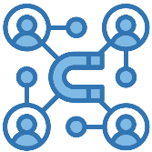
Common design patterns
Code generation agent
RAG agent
Multi-agent systems
Multi-domain agent systems
Notes:
Speaker notes:
Agentic AI systems follow certain design patterns that ensure they operate effectively and efficiently. Common patterns include Retrieval-Augmented Generation (RAG) agents, which improve the quality of answers by using external knowledge. These patterns also include multi-agent systems, where specialized agents work together to tackle complex problems. These design patterns are essential in building scalable and robust AI agents that can adapt to various tasks and environments.
Source: Azure AI Agent Service L300 Pitch Deck (link not available)

Slide 41

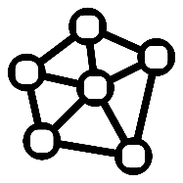

Retrieval Augmented Generation agent
Translates questions into a research problem with human in the loop to produce high quality answers to complex questions within the scope of its domain.
Intelligent RAG agent
Plan
question
Query
Knowledge Graph
discussion
Observe
Update plan
final answer
Compile answer
Search Tools
Notes:
Speaker notes:
Retrieval-Augmented Generation, or RAG, agents are a powerful tool for tackling complex questions. These agents take a question, break it down into smaller parts, and engage in a dynamic research process to gather relevant data, refine their understanding, and deliver high-quality, well-supported answers. This process involves multiple iterations and human-in-the-loop feedback to ensure the final answer is accurate and comprehensive.
Source: Azure AI Agent Service L300 Pitch Deck (link not available)

Slide 42
Code generation agent
Generates code based on natural language requirements, leveraging existing code base, templates, guidelines, libraries to match policies and proven practices while interacting with humans to clarify, validate and deliver functionality as intended.
Code w/ Tests, Doc, DevOps code, etc
Dev Task
(spec / bug / feature)
Planning & tracking
Coordinator
Human interaction
Multi-turn reasoning and action (ReAct)
Session and memory management
Code Executor
Toolsets & coding interface
Constraints
Existing Codebase
Coding Guidelines (docs)
Internal SDKs
Dynamic context look-up
Notes:
Speaker notes:
Code generation agents represent another breakthrough in agentic AI. These agents can take natural language requirements and generate code, using existing templates, libraries, and proven practices. They engage with human developers for clarification and validation, ensuring that the code produced is both functional and aligned with project needs. This hybrid approach increases productivity and accelerates development cycles.
Source: Azure AI Agent Service L300 Pitch Deck (link not available)

Slide 43

Multi-agent system
A complex problem is decomposed into smaller, manageable parts, each addressed by specialized agents, effectively a micro-service (MS). These agents work together in a coordinated manner within a workflow to efficiently solve the overall problem.
Critical Design Elements
Adaptive planning within scope of existing tightly scoped skills (agents)
Handles ambiguity by discussing and refining requirements with human
Memory to handle complex long running execution of a plan
Effective inter agent communications
Test, monitor, release, and maintain each agent independently to quickly handle quality and safety issues
MS #3
Memory
history of work
User Proxy agent
Coordinator agent
LLM
conversation
MS #1
MS #2
Retrieval
agent
LLM
Coding
agent
SLM
query
data
Search
Coding Guidelines
docker
Notes:
Speaker notes:
Multi-agent systems break down complex tasks into smaller, more manageable components, each handled by specialized agents. For example, in a multi-agent system for software development, a coordinator agent manages the overall workflow, while retrieval agents and coding agents focus on specific tasks. This distributed approach allows each agent to focus on what it does best, while coordinating efforts to efficiently solve the larger problem. Memory and inter-agent communication are crucial for keeping the system running smoothly.
Source: Azure AI Agent Service L300 Pitch Deck (link not available)

Slide 44


Multi-domain agents system
Multiple domain-specific agents are orchestrated by an Agent Runner to scale across multiple domains while appearing as a single agent to users.
Critical Design Elements
Agents' capability descriptors
Scalable Agent Runner able to manage 10s to 100s of agents
Ability to manage domain switching with proper memory management
Avoid single interceptor problem as individual agents maintain direct communication with user and can hand off when needed
Agent pool
Role/goals
+ skills
Role/goals + skills
Role/ goals+ skills
Run + Back-off
Run + Back-off
Run Back-off
Agent 1
Agent 2
Agent n
Agent Runner
Shared context memory
Active Agent
Revaluate agent assignment
Transfer
Run
Notes:
Speaker notes:
Multi-domain agent systems represent a significant leap in how AI can scale and handle diverse tasks. In this model, domain-specific agents are orchestrated by an 'Agent Runner,' which allows them to work across multiple domains while presenting themselves as a single agent to the user. The design is built to handle scalability, ensuring the ability to manage hundreds of agents. A key feature is the shared context memory, which allows agents to transfer knowledge and coordinate with each other seamlessly. This system is efficient, highly adaptable, and ensures that tasks are handled without bottlenecks, even as the scope of responsibility increases.
Source: Azure AI Agent Service L300 Pitch Deck (link not available)

Slide 45


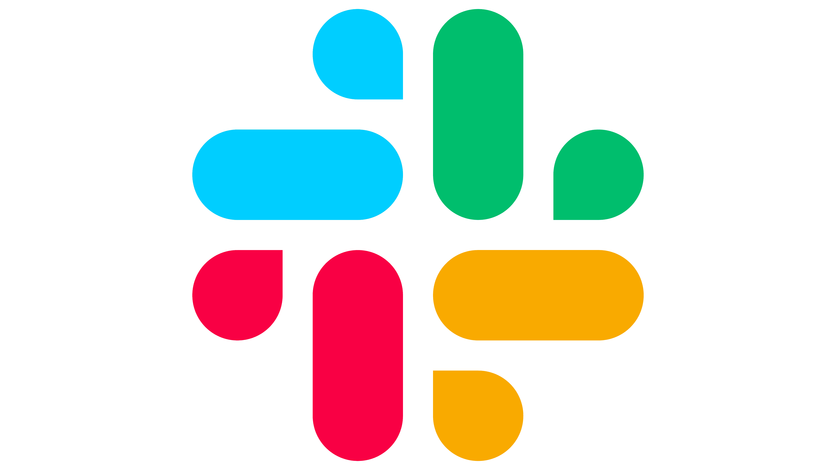




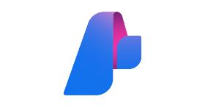



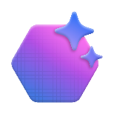





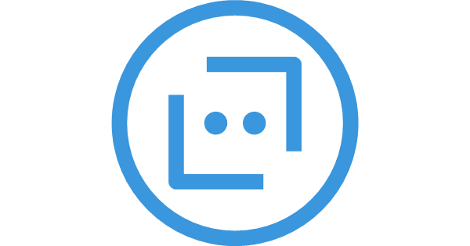



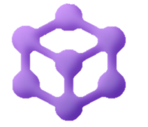



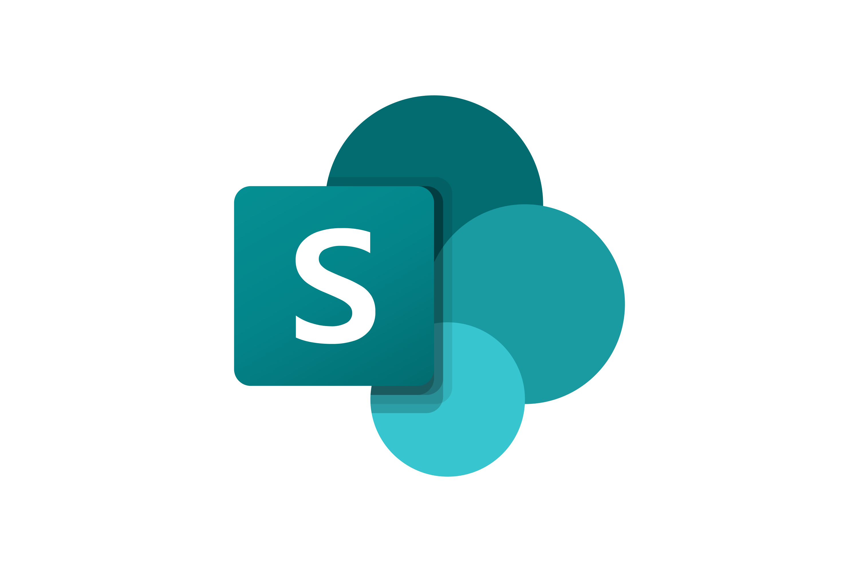



Recommended “Golden Path” architecture
BYO resources
Microsoft Foundry Standard setup
Cosmos DB Thread storage
Key vault Connections
Built-in AI tools
Agents
Models
Azure Storage File storage
File search
Code interpreter
Bot Service Channels
Azure AI Search File search index
AI tool resources
Azure AI Search
Grounding with Bing Search
Agent Framework Multi-agent orchestrator
Logic Apps
Azure Functions
Azure Container Apps
Fabric
SharePoint
External APIs OpenAPI specs
MCP servers
A2A Servers
Notes:
Speaker notes:
This slide presents the recommended 'Golden Path' architecture for building agentic AI solutions on Azure. Think of this architecture as a reference blueprint that brings together all the essential components needed for scalable, secure, and robust AI agent deployments.
Let’s walk through the main elements of this architecture and discuss how they work together:"
Data Storage and Security: We use Cosmos DB for thread storage, Azure Storage for file storage, and Key Vault for managing secure connections and secrets. These ensure data is accessible, persistent, and protected."
AI and Agent Services: Azure AI Foundry provides the standard setup for deploying and managing AI models and agents. The architecture supports both built-in and bring-your-own (BYO) resources, giving flexibility for custom solutions. Microsoft Agent Framework (formerly Semantic Kernel and AutoGen) acts as the multi-agent orchestrator, enabling coordination between agents and integration with external APIs.
Application and Integration Services: Azure App Service and Azure Container Apps are used for hosting applications and deploying scalable services. Azure AI Search powers file search and indexing, while Logic Apps and Azure Functions enable workflow automation and custom logic.
External Integrations: The architecture supports integration with external APIs (using OpenAPI specs), SharePoint, Microsoft Fabric, and other enterprise systems, allowing agents to access and act on a wide range of data sources.
Security, Governance, and Monitoring: Zero-trust guardrails, audit logging, and built-in governance tools are included to ensure compliance, security, and responsible AI practices. Application Insights and Log Analytics provide monitoring and observability for ongoing operations.
This modular approach allows organizations to start with a solid foundation and extend or customize components as needed for their specific use cases.
Following a reference architecture like the Golden Path helps teams avoid common pitfalls, ensures best practices for security and scalability, and accelerates time-to-value for AI projects. It also makes it easier to demonstrate compliance and governance, which is increasingly important in regulated industries.
Source: Azure AI Agent Service L300 Pitch Deck (link not available)

Slide 46













System architecture: component view
Cloud AI Services
Hosted Foundation Models
Custom ML Models
Responsible AI
Azure AI Services
External Systems
Internet Services: Bing, Google, SERPAPI
Enterprise DB
Agent Services
Application Services
User Experience
Code Execution Service
Agent Orchestration Services
App Backend Services
App Frontend Service
Client Applications
Text
Voice
vision
Azure AI
Agent Service
AutoGen
Agent Framework
App Databases
Current Memory
Long Term Memory
Small Language Model
API Management
Network Security and Access Management
Logging and Monitoring
Notes:
Speaker notes:
This slide breaks down the components involved in the agentic system, detailing the key services that allow for the orchestration and execution of multi-agent workflows. We have cloud AI services, including custom models hosted on Azure Machine Learning and other foundational models from Azure OpenAI and Mistral AI. External systems are integrated via internet services like Bing and Google APIs, providing real-time grounding for agents.
The architecture includes various Agent Services, such as code execution, which runs and compiles tasks, and memory services, which manage both current and long-term agent memory, ensuring persistence in interactions. App backend and frontend services, powered by Azure, manage the interaction layer with the end users.
Source: Azure AI Agent Service L300 Pitch Deck (link not available)

Slide 47
Innovate with Azure AI Apps and Agents discussion
What customer success metrics (e.g., reduced time to deploy, increased engagement, cost savings) could be directly impacted by these technologies?
Which agentic AI capabilities (e.g., planning, memory, collaboration) do you think are most critical for real-world applications, and why?
Notes:
<Coach> Invite participants to come off mute or share in chat their answers to the questions on this slide.

Slide 48
AI Gateway, Governance, and Modal Context Protocol
Notes:
<Coach> This section covers key info on the architecture of agentic AI solution, ending with a ‘Recommended “Golden Path” architecture’ slide to be used not as a must-have, but as a reference point for the following discussions/ exercises.
Source: Azure AI Agent Service L300 Pitch Deck (link not available)

Slide 49
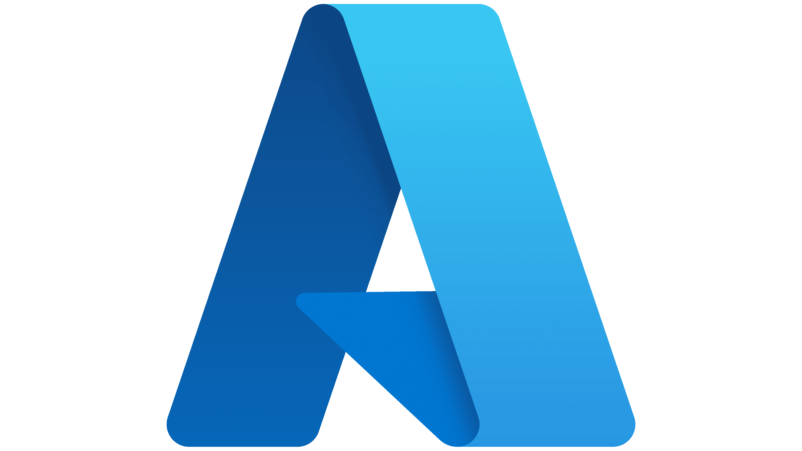



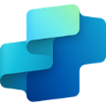




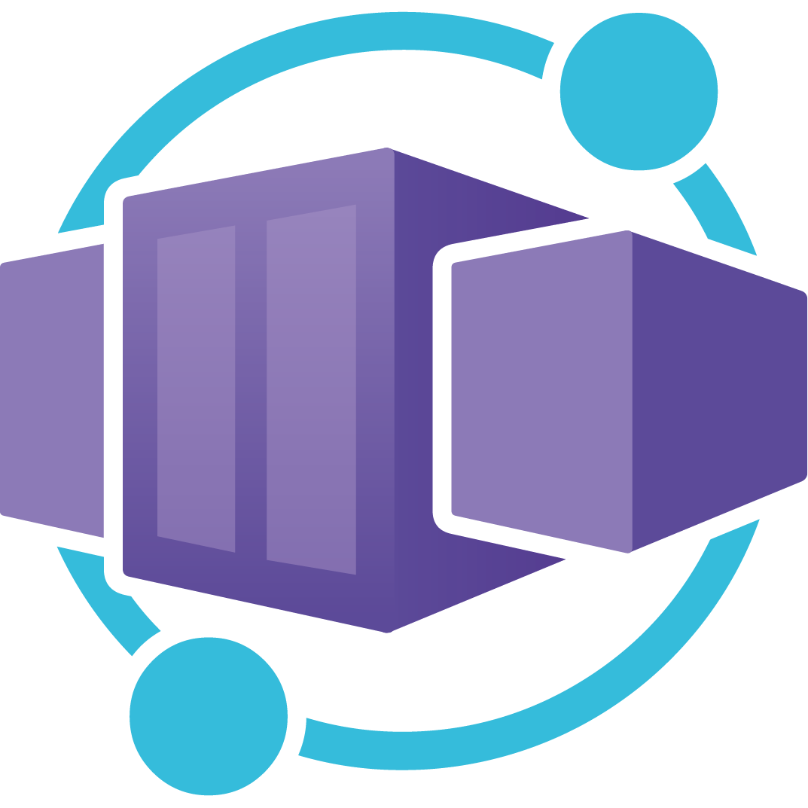




Model Context Protocol (MCP) at Microsoft
The emerging industry standard for connecting AI Agents to Enterprise Systems
MCP servers across Microsoft
Build your own and publish
Call from MCP clients anywhere
Azure
Foundry Tools
Azure Logic Apps
Azure API Center
Agent Service
Copilot Studio
GitHub
Azure Logic Apps
Agent 365
Azure
Functions
Azure App
Service
Azure Container Apps
VS Code
GitHub Copilot
Secure access and governance
Azure API Management
Entra ID
Notes:
Original talk track from source: Ignite 2025 AI Summary Deck (slides 42 and 43)
Enter The Model Context Protocol, or MCP, which quickly becoming the industry standard for connecting AI agents to enterprise systems.
It’s not just Microsoft—major players like OpenAI, Google, DeepMind, AWS, and Hugging Face are all adopting MCP.
Microsoft is proud to have seats on the MCP steering committee, and we’re actively working to improve the specification, especially around security.
With MCP, we’re moving toward a unified, secure way for agents to access tools and data across the enterprise.
This is great – we can see there is a lot of potential.
Microsoft is making MCP servers secure and easy to manage for enterprise use.
Today we are going to talk about how we are making Azure and Microsoft Foundry the most interoperable AI platform – using MCP.
We are going to cover how we are bringing all of our services online with MCP servers.
And We are going to demonstrate how simple it is to get started, and the power of the workflows that you can create.
We will cover data and IQ briefly – and we will show how your org and build custom MCP servers: hosting and governing them right in Azure – with complete governance end to end.

Slide 50
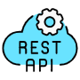

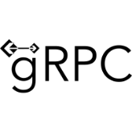


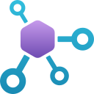








API Management is a unified gateway
For traditional, model, tool, and agent APIs
Traditional API Gateway
Design
REST
GraphQL
WebSocket
gRPC
Analyze
Develop
AI Gateway
Models Gateway
API Management
Monitor
Secure
Microsoft Foundry
AWS Bedrock
Google Vertex AI
Open AI
Anthropic
Mistral
Tools Gateway
Agents Gateway
Scale
Publish
MCP
OpenAPI
A2A
REST or other HTTP
Notes:
API Management also lets you convert traditional APIs to MCP tools for consumption by AI agents
Traditional APIs > Traditional API Gateway
AI APIs > AI Gateway
Models > Models Gateway
Tools > Tools Gateway
Agents > Agents Gateway
Original talk track from source: Ignite 2025 AI Summary Deck (slides 52-54)
[empty]

Slide 51









AI Gateway as the bridge to mediate AI usage
Clients
AI models, tools, agents
AI Gateway
AI Models
Users
Governance
Apps & services
Scalability
Tools (MCP servers & APIs)
Security & Safety
Agents
Observability
Agents
Copilots
Velocity

Slide 52
AI Gateway, Governance, and Modal Context Protocol discussion
What steps should be taken to ensure privacy, security, and responsible governance when building and deploying generative AI systems?
Thinking about one of your customers, where would adopting an AI Gateway and the Model Context Protocol most immediately reduce risk or complexity in how they connect agents to enterprise systems—and why?
Notes:
<Coach> Invite participants to come off mute or share in chat their answers to the questions on this slide.

Slide 53
Wrap-up discussion
How does the agentic AI approach differ from traditional generative AI, and what new opportunities does it create for organizations?
Can you explain how a compelling AI Frontier solution could benefit one of your real-life customers?
Notes:
<Coach> Invite participants to come off mute or share in chat their answers to the questions on this slide.

Slide 54
Q&A
Share your questions about agentic AI.
Notes:
<Coach> After reviewing the Solution Play, review if there are any questions.

Slide 55

Zava
#29
Meet the customer
Notes:
<Coach>
Introduce the Case study that will be used throughout the workshop.
Explain its importance on how the case study ties to real-world scenarios you might encounter in you daily base situation.

Slide 56

Case study: Zava overview
Let's review the Zava customer case that we will use throughout this course.
Zava is a popular online outlet for home goods, including consumer appliances, power tools, and paint.
By embedding generative AI into core business functions, the company aims to reduce operational costs, improve efficiency, and unlock new revenue opportunities.
Zava has identified three potential use cases:
Developing agents for customer interaction.
Developing agents for internal analysis.
Using agentic DevOps to speed development and improve developer experience.
Notes:
Zava, a leading online retailer for home goods, is investing $6 million USD into generative AI to enhance customer experience and internal efficiency. This initiative spans the full AI lifecycle—from experimentation to production—and includes infrastructure, talent acquisition, and responsible governance. The company aims to embed AI into core functions to reduce costs, boost productivity, and generate new revenue. Key goals include enabling staff to analyze sales data for strategic planning and offering personalized customer guidance beyond generic blog-style advice.
Three primary use cases have emerged from customer meetings. The first involves developing agents for customer interaction, to offer interior design advice and product recommendations. Another use case is developing agents for internal data analysis, to streamline access to internal lakehouse data for marketing insights. The customer emphasizes the need for strict controls to prevent unauthorized data exposure and invalid discount offers. The third use case explores Agentic DevOps to improve deployment speed and developer experience using GitHub tools.
Let’s examine more deeply the first of Zava’s use cases: building a virtual assistant for customers.
Then we’ll break into teams to discuss possible solutions.

Slide 57

Case study: A personalized virtual assistant
Zava wants to build an agentic AI virtual assistant to advise customers on interior design. The assistant should:
Recommend products from Zava’s catalog aligned with design suggestions.
Deliver real-time, context-sensitive guidance through a chat interface.
Enhance customer engagement and satisfaction with tailored experiences.
Drive product discovery and increase conversion rates.
Reduce operational costs by automating advisory services.
Unlock new revenue opportunities through intelligent recommendations.
Strengthen Zava’s market position with innovative, customer-facing services.
Notes:
<Coach> Review the information on the required capabilities of the agentic AI virtual assistant.

Slide 58

Case study: Customer requirements
At a high level, Zava has expressed these requirements:
The design advice agent must run on the Zava website, accessible via desktop, tablet, and mobile—no installs required.
The agent may reference general design info but must only promote Zava products.
All AI agents must prevent disclosure of sensitive data.
AI agents will analyze internal sales data without exposing specific figures.
Developers use C#, JavaScript, and Python; solutions must use one or more of these.
Notes:
<Coach> Review the information on customer requirements.

Slide 59

Case study: Customer objections
Zava doesn’t have in-house AI engineering expertise. You may encounter some or all the following objections:
We don't have in-house AI engineering expertise.
What about flexibility? We're concerned about model lock-in and future-proofing.
How can we guard against inappropriate model behavior or unsafe outputs?
How do we avoid possibly catastrophic actions by agents, for example, data deletion?
We have heard that code generation tools don’t always increase productivity.
The results of code generation don’t follow proven practices and require a more senior engineer to improve the output.
Notes:
<Coach> What is holding the customer back?

Slide 60





Zava key contacts
Kadji Bell,
Chief Information Security Officer
Kian Lambert,
Application Development Manager
Tim de Boer, Marketing Manager
Lydia Bauer, Enterprise IT Architect
Dedicated CISO with a talent for leading cross-functional teams. Known for her organizational prowess and strategic mindset, Kadji excels in safeguarding organizational data and ensuring compliance with security standards.
Talented software developer with a passion for creating innovative solutions. Known for his problem-solving skills and attention to detail, Kian excels in developing efficient and scalable applications. His collaborative nature and strong technical expertise make him an invaluable team member.
Dynamic marketing strategist with a knack for creating impactful campaigns. Known for his creativity and analytical skills, Tim excels in driving brand growth and engagement.
Innovative enterprise IT architect known for designing robust IT solutions. With strategic thinking and excellent communication skills, Lydia excels in aligning technology with business goals.
60
Access complete decision maker details in your Student Guide.
Notes:
<Coach> Introduce students to the different customer roles students may encounter in conversations.
Speaker notes:
“Now, let’s look at some of the key customer roles you might encounter when having conversations with Zava.”
“Understanding these roles will help you tailor your approach and messaging to each stakeholder’s unique priorities and concerns.” “These roles are based on the real needs and challenges described in the Zava case study.”
“As you prepare for the next activities, keep in mind the specific pain points and objectives each persona represents.”
Tip for Coaches:
Encourage students to ask clarifying questions about each role.
Remind them that understanding the customer’s perspective is key to building trust and delivering relevant solutions.

Slide 61
Technical envisioning and architecture session intro
Setting the stage
Purpose: Simulate a real-world technical envisioning session with Zava.
Context: Apply the 4-step envisioning process:
Positioning – Understand Zava’s business goals.
Business Envisioning – Identify pain points and future-state aspirations.
Solution Assessment – Evaluate technical options.
Technical Envisioning – Co-create a solution architecture.
Your role: Act as the Solution Engineer guiding the customer through architecture design.
Exercise overview
Notes:
Whole exercise is 60 minutes. Breakdown:
Exercise overview – 5 minutes
Analyze customer and prepare for architecture – 20 minutes
Whiteboard architecture – 30 minutes
Discuss – 5 minutes
<Coach>
Briefly cover the envisioning process and point out that in today’s whiteboarding session they will focus on Step 4 – Draft a technical architecture using MS Whiteboard.

Slide 62
Whiteboarding for technical envisioning
Whiteboarding exercise
Challenge:
Uncover customer pain points, strategic goals, etc.
Draft a Microsoft Azure AI agentic architecture design that meets Zava’s requirements.
Tasks:
Discuss Zava’s priorities and needs as a team.
Practice the architecture portion of a technical envisioning session.
Exercise overview
Notes:
<Coach>
Challenge: Draft a Micro Azure AI agentic architecture design that meets Zava’s requirements.
Tasks: Discuss as a team and then practice leading the architecture portion of a technical envisioning session.
One student will download the template, share the template with others from their machine, and then share their screen.
As a team they will work together using their analysis of Zava to construct a draft architecture

Slide 63
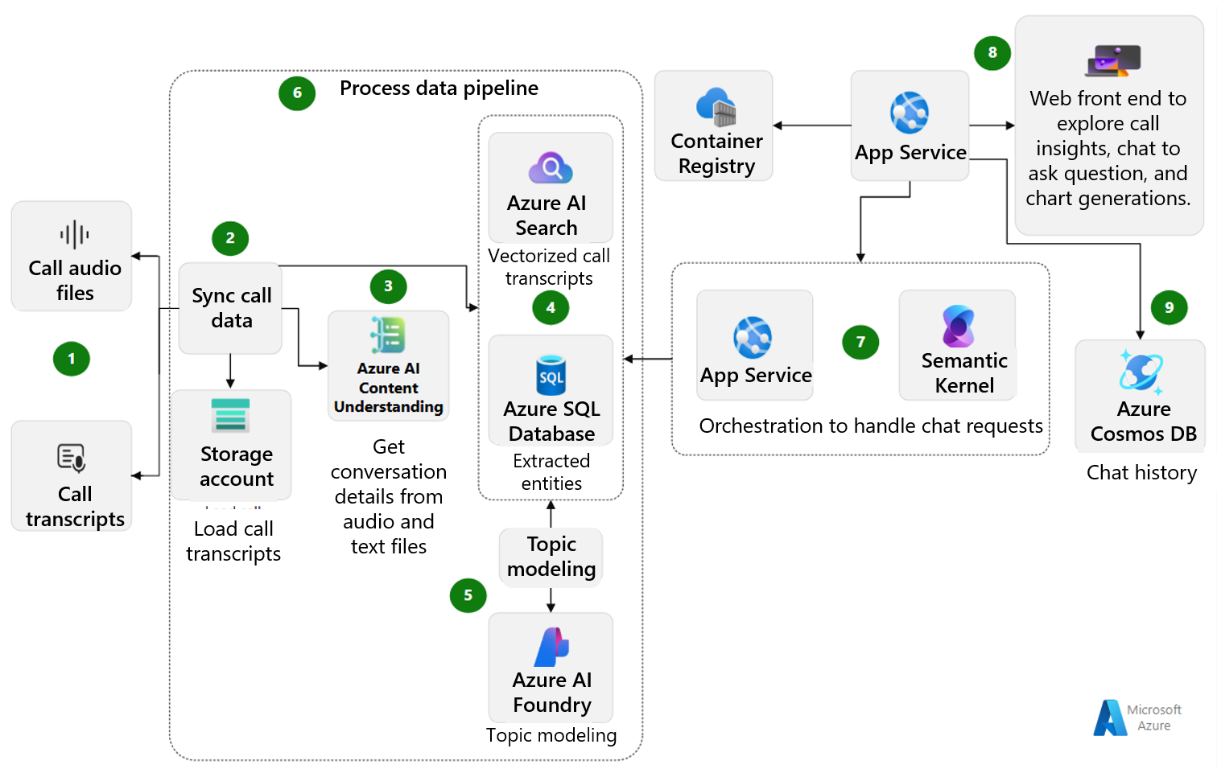
Published pattern one
Build a conversation knowledge mining solution by using Azure AI services
Microsoft Foundry
Notes:
<Coach guidance> Don’t cover this deeply. Simply mention it as a published pattern and that it and the link to its article are in their Student Guide.

Slide 64
Published pattern one
Build a conversation knowledge mining solution by using Azure AI services
Microsoft Foundry
Notes:
<Coach guidance> Don’t cover this deeply. Simply mention it as a published pattern and that it and the link to its article are in their Student Guide.

Slide 65
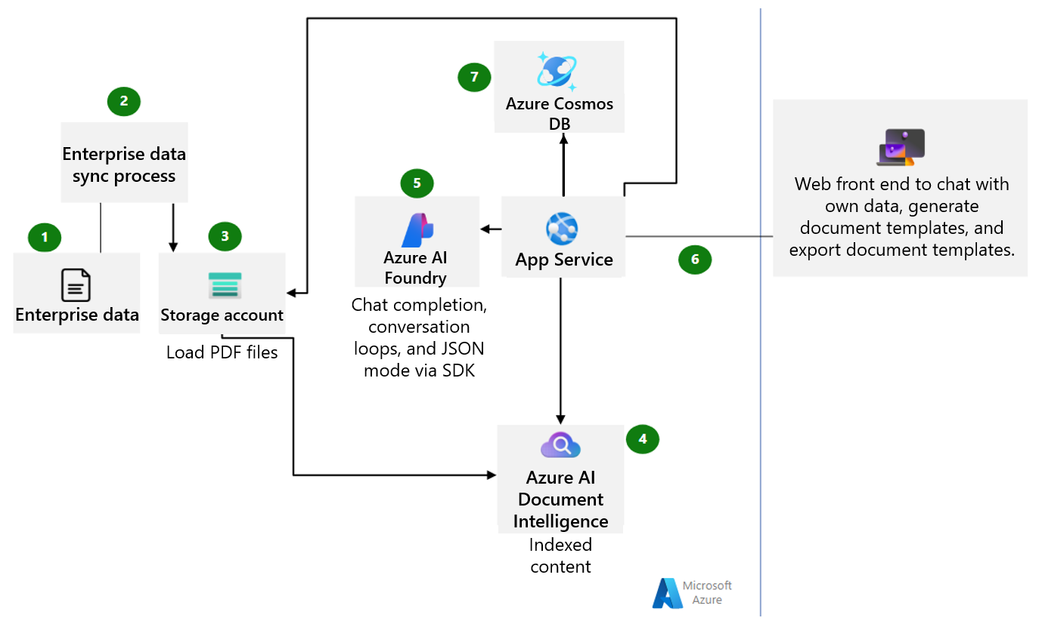
Published pattern two
Build a document generation system by using AI
Microsoft Foundry
Notes:
<Coach guidance> Don’t cover this deeply. Simply mention it as a published pattern and that it and the link to its article are in their Student Guide.

Slide 66
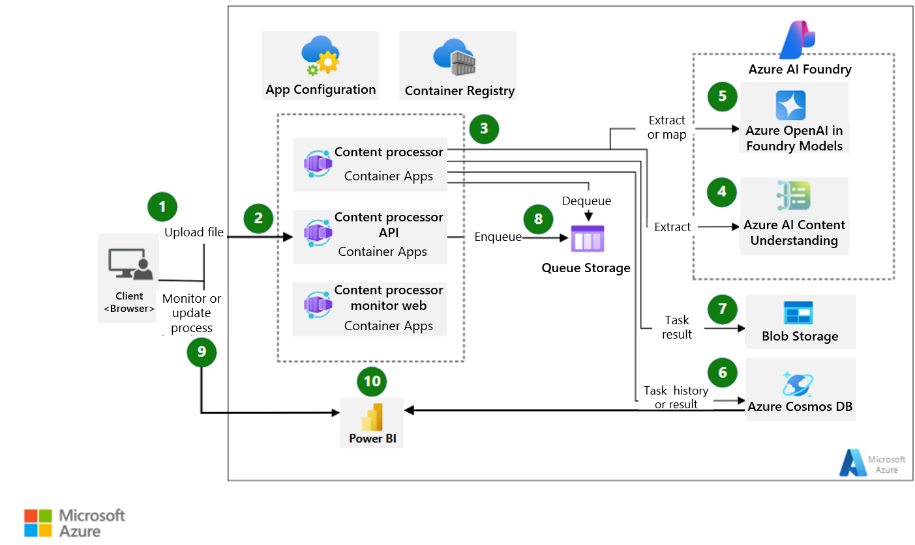
Published pattern three
Extract and map information from unstructured content
Microsoft Foundry
Notes:
<Coach guidance> Don’t cover this deeply. Simply mention it as a published pattern and that it and the link to its article are in their Student Guide.

Slide 67
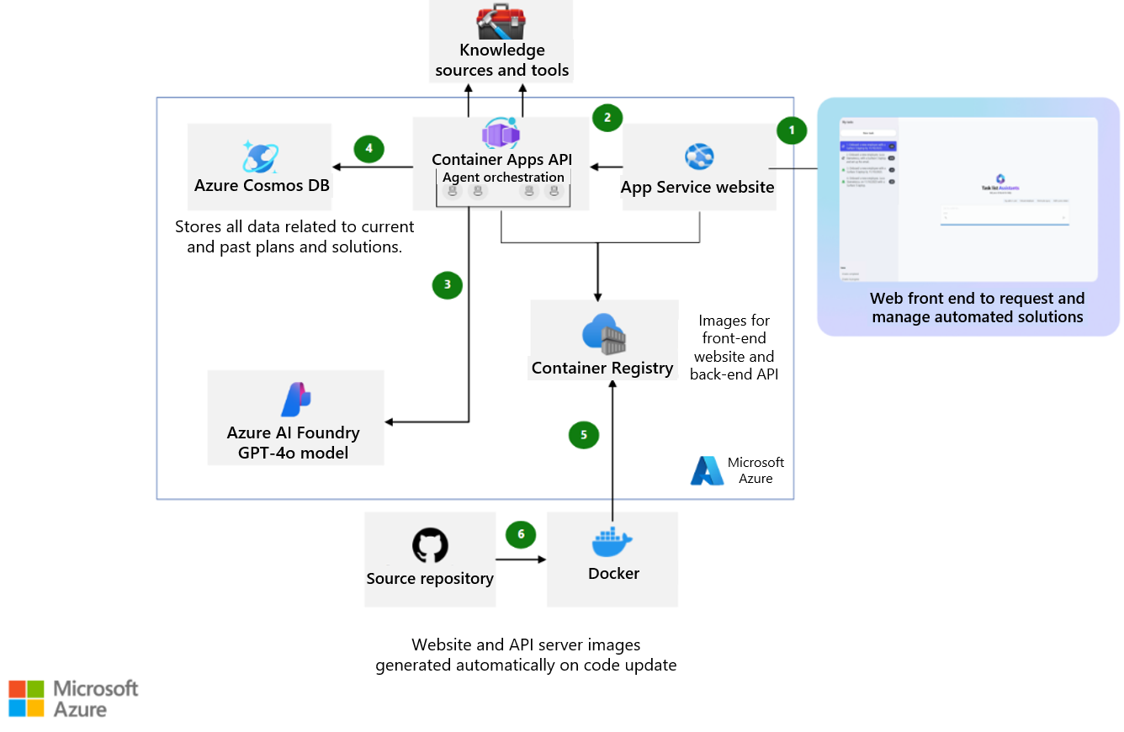
Published pattern four
Build a multiple-agent workflow automation solution with Microsoft Agent Framework
Microsoft Foundry
Notes:
<Coach guidance> Don’t cover this deeply. Simply mention it as a published pattern and that it and the link to its article are in their Student Guide.

Slide 68
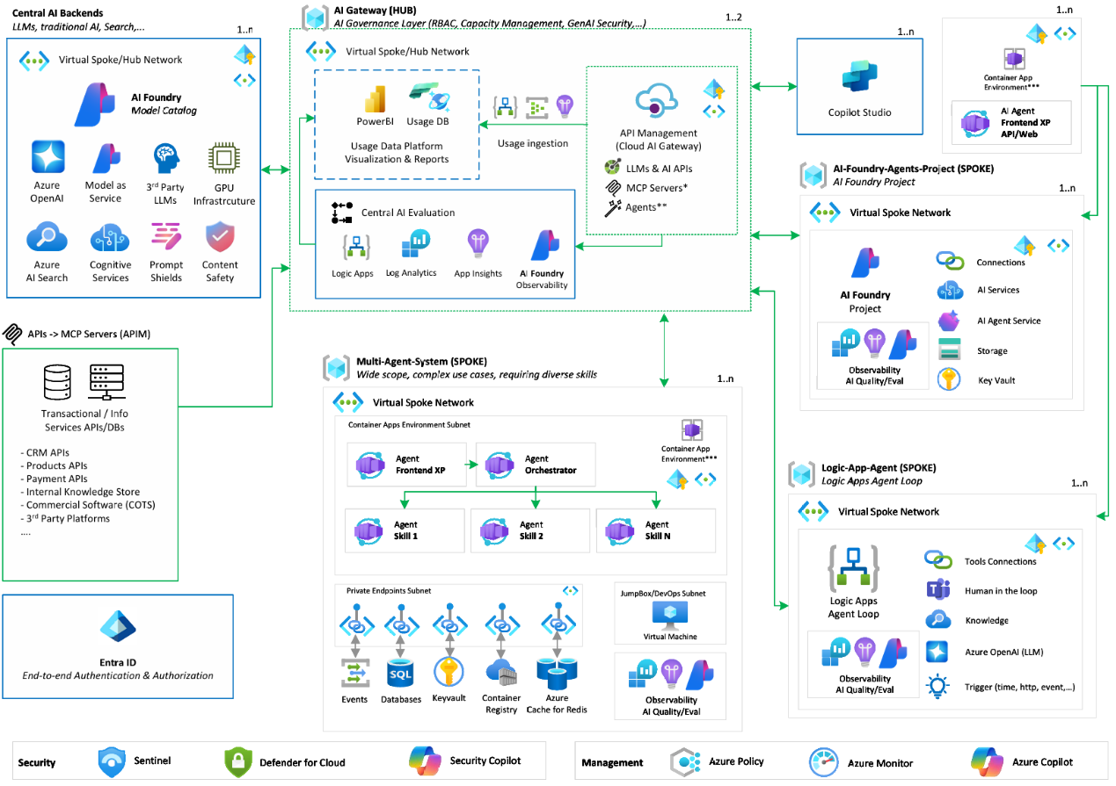



How it all comes together – a sample architecture
Microsoft Foundry
Governance & Security
Foundry
Foundry
AI Development Velocity
Observability & Reliability
Notes:
Let’s have a look at AI Citadel Architecture, which is designed to enhance security, governance, and monitoring through the integration of various AI, data and apps components.
Key elements include the
AI Gateway, which serves as the entry point for AI services providing secure and govern access to generative and traditional AI
When it comes to deploying agentic applications in production, it's essential to also incorporate best practices in security, governance, monitoring, and reliability for AI agent apps.
This sample architecture and the technical patterns are in your Student Guide.

Slide 69
What’s ahead? Lab exercises
Notes:
<Coach> Introduce participants to the exercises section of the workshop.

Slide 70

Approach to exercises
Review lab exercise proven practices.
Engage with your team members and share your wins and struggles.
Ask your Coach when you have questions or need help.
Debrief exercises.
Notes:
<Coach> Share highlights of the team approach to the exercises.

Slide 71
Lab overview scenario
Scenario
The following exercises will have you work through a customer proof of concept regarding Microsoft Foundry.
The scenario entails building a proof of concept for Zava, a retail chain that specializes in "do-it-yourself" solutions for home improvement projects.
Zava would like to build a shopping assistant that helps customers choose the correct products for their own home improvement projects. Customers will be able to upload images and short videos, ask questions regarding the set of products available from Zava, and make purchases, all from a multimodal chat interface.
Notes:
<Coach>
Begin by introducing the students to the lab environment and the associated GitHub IO page. Provide a walkthrough of the entire scenario, outlining the objectives, main tasks, and key activities they will be working on.
As you explain each element, emphasize its significance and how it connects to real-world situations. Help students understand not only what they are doing but why it matters—highlighting how these tasks mirror the challenges and workflows they may encounter in professional settings.

Slide 72
Today’s lab exercises
Exercise one: Deploy application resources​ – 60 minutes
Tasks:
Deploy a Bicep script​.
Configure Azure resources​.
Prepare datasets.
Exercise two: Implement a multimodal AI shopping assistant – 60 minutes
Tasks:
Create a single-agent solution​.
Create a multi-agent solution.​
Deploy to Azure.
Notes:
<Coach>
Present a roadmap of the exercises for the rest of the day.
Your goal is to present the “what,” the high-level goals and outcomes.
Coaches in the breakouts will present the detailed “why” and “how,” the specific instructions for completing the exercises.
Whiteboarding – 60 minutes
Challenge: Draft a Microsoft Azure AI agentic architecture design that meets Zava’s requirements.
Tasks: Discuss as a team and then practice leading the architecture portion of a technical envisioning session.

Slide 73
Breakouts
Join your team to complete the exercises
Notes:
<Coach> Display the slide to signal everyone’s readiness to move to their own teams.

Slide 74
Join your breakout room
1
3
Find your workshop in Teams.
Join the channel. DO NOT start a meeting.
2
Find your Team channel.
Notes:
<Coach>
1 minute
<Coach> the moderator will share who goes to each Breakout Team
Say: To join your breakout team:
Find your workshop in Teams.
Find the Team channel you are assigned to. There will be several active Team channels.
Join the channel, DO NOT start a meeting.

Slide 75

Meet your team
DO NOT START A NEW CALL!
Join the meeting your Coach started
Having difficulty finding or joining your assigned Team channel?
Stay here in the General channel and let us know. We’ll figure it out together!
Get ready to introduce yourself to your teammates.

Slide 76

Turn on your camera!
Develop professional connections.
Rehearse your narrative in front of a customer.
Increase engagement with other students.
Notes:
<Coach>
Encourage students to stay on camera, unless bandwidth is an issue.
Turn camera on when asking a question or sharing information with the team.

Slide 77
Technical envisioning and architecture session
Whiteboard the architecture

Slide 78
Analyze Zava’s needs Technical discovery exercise
Purpose
Prepae for a technical envisioning session with Zava.
Analysis exercise
Interview the Zava representative with you (the coach)
Analyze the responses and the Zava case study as a team to identify the priority strategic, business, and technical requirements to address in the solution.
Use the following resources to assist:
Provided whiteboard template
AI Discovery Questionnaire
Decision Tree for Databases, App Hosting, and Integration
Use Case Prioritization Matrix
Expected outcomes
Clear understanding of Zava’s business goals and pain points.
Prioritized use cases based on feasibility and impact.
Initial roadmap and architecture direction.
Identification of gaps and dependencies.
Notes:
Students will have 20 minutes to analyze the customer and prepare for the technical envisioning whiteboarding that comes next.
They will align on the customer’s needs and begin shaping the solution direction using structured tools.
Remind student to outline the key customer requirements such as safeguarding internal data, preventing misuse of discount offers, tracking telemetry for audit and governance, and planning ahead toward developing agentic AI for internal Zava staff to query for marketing data.

Slide 79
Architecture design Exercise
Purpose
Draft a Microsoft Azure AI agentic architecture design that meets Zava’s requirements.
Architectural Exercise
Identify key services.
Explain which components, connections, and dependencies you should include and why.
As a team, discuss how to explain the architecture to the customer.
Consider
Creating safeguards for data protection and discount validation.
Alignment to the desired development stack.
Governance and compliance.
Flexibility in the design to avoid model lock-in.
Using multi-agent orchestration with fallback and escalation paths.
Notes:
Coach guidance
Students will have 30 minutes to draft, as a team, an agentic AI architecture to meet Zava’s requirements.
They can use Microsoft Whiteboard (in Teams or in the standalone app) or the tool of their preference to create their draft (only if whiteboard template doesn’t work).
Remind student to align to the key customer requirements they detailed in the analysis phase.
Ask students to consider the following guidelines to align their architecture design:
1. AI development strategy
What guardrails must be in place before deployment?
How will you prevent AI from generating content from unauthorized sources?
How will agents be governed?
2. Auditing and compliance strategy
Which logs, tools, and telemetry would you use to demonstrate compliance?
How would you respond to a regulatory audit or security incident involving GenAI?
As a team, help them summarize the main points discussed and emphasize the importance of architectural planning, including scalability and future-proofing, in AI adoption.

Slide 80
Discussion
How does the architecture meet Zava’s goals? Are there gaps? Are there opportunities for further discovery with Zava?
Does the architecture address Zava’s concerns? For example, does it address their lack of developer expertise in AI, and the prospect of model lock-in?
What does agentic AI offer in this solution, beyond what can be done with non-agentic generative AI?
How does this architecture support compliance and responsible AI practices?
Notes:
<Coach guidance> Present the lab details to the students, focusing to highlight the “WHY” of the steps in the lab exercise – it will help the students to connect the lab exercise to real-life scenarios.

Slide 81
Exercise one
Deploy application resources​
Notes:
<Coach>
Introduce exercise one.

Slide 82
Exercise one
Overview Deploy application resources​
Scenario
In this first exercise, we’ll set the stage for Zava by deploying out resources needed for the proof of concept, as well as ensuring that we have the client tools necessary to run through the remaining exercises.
Objective 1
Use a Bicep script to provision Azure resources.​
Objective 2
Load data into Cosmos DB and Azure AI Search​.
Objective 3
Create resources in Microsoft Foundry and connect Azure resources to an existing project.
Notes:
<Coach guidance>
Using the GitHub I/O pages, review the scenario and objectives to set the important “WHY” of the steps in the lab exercise. The “WHY” helps the students to connect the lab exercise steps to real-life scenarios.
Remind the students to download these slides for tips and reminders during the lab exercises and for support if doing the lab exercises again later on their own

Slide 83
Choose an appropriate region and model
Some of the assets you will create during this training are only available in select regions, including:
East US 2
Sweden Central
France Central
Switzerland West
The training mentions two models:
Phi-4
gpt-4o
If you prefer to use a different GPT model like gpt-4.1 or gpt-5-mini, you are welcome to use it instead.

Slide 84









Exercise one architecture
App Service
Plan
AI Search
Cosmos DB
App Service
Microsoft Foundry
Container
Registry
Storage
Account
Application
Insights
Log Analytics
Workspace
GitHub
Notes:
<Coach>
Review the architecture diagram for this lab.

Slide 85
Exercise two
Implement a multimodal AI shopping assistant
Notes:
<Coach>
Introduce exercise two.

Slide 86
Exercise two
Overview Implement a multimodal AI shopping assistant
Scenario
In this exercise, we’ll build a series of agents and test them locally before deploying the application code to Azure.
Objective 1
Build a chat application that allows customers to research products, add products to a cart, and receive loyalty discounts​.
Objective 2
Incorporate multiple AI agents to satisfy specific customer needs​.
Objective 3
Deploy apps to Azure from Visual Studio Code.
Notes:
<Coach guidance> Use the GitHub I/O pages to introduce the lab exercise and review the objectives to give the students the important “WHY” of what they’ll be doing.
Speaker notes:
Previously, you deployed a series of resources within Azure that will be necessary for Zava's AI proof of concept. Now, Zava would like to see how Azure AI Foundry services can enable them to create a multimodal AI shopping assistant.

Slide 87
Exercise two architecture
AI Search
App Service
Plan
Zava agents
Router
Shopping Assistant (Cora)
Interior Design
Inventory
Customer Loyalty
App Service
Phi-4 Deployment
GPT-4o Deployment
Microsoft Foundry
Container
Registry
Storage
Account
Notes:
<Coach>
Review the architecture diagram for this lab.
Exercise two summary
In this exercise you:​
Built a chat application allowing customers to research products, add products to a cart, and receive loyalty discounts.​
Incorporated multiple AI agents from Azure AI Foundry to meet specific customer needs​.
Hosted the application in an Azure App Service.

Slide 88
Exercise one
Debrief Deploy application resources​
Debrief question #1
Did you have any challenges with deployment?
Debrief question #2
What factors influence the Azure region to use when working with a customer?
Debrief question #3
What steps would you take to verify that everything is set up correctly for the next phase of the project?
Notes:
<Coach>
Read the debrief questions to engage students in a conversation about the lab.

Slide 89
Exercise one
Debrief Implement a multimodal AI shopping assistant
Debrief question #1
What were the main differences between building a single-agent and a multi-agent solution?
Debrief question #2
Which features of the multimodal chat application do you think will be most valuable for Zava’s customers, and why?
Debrief question #3
How did you incorporate multiple AI agents to address specific customer needs, and what challenges did you face in agent integration?
Notes:
<Coach>
Read the debrief questions to engage students in a conversation about the lab.

Slide 90
Day one wrap-up and Q&A
Notes:
<Coach guidance> Go through the summary of day one and answer any remaining questions.

Slide 91
Lab outline – day one complete
DAY ONE
DAY TWO
Exercise one
Deploy application resources
Exercise three
Extend the shopping assistant using the A2A protocol
Exercise four
Observe model utilization in Microsoft Foundry
Exercise two
Implement a multimodal AI shopping assistant
Exercise five
Agentic DevOps
Exercise six
AI-enhanced red teaming
Notes:
<Coach> Review with students the exercises they completed for day one and the exercises they will complete on day two:
Day 1 – Title(s) and lab main objective
Day 2 – Title(s) and lab main objective

Slide 92
Day one key takeaways
1. Possible key takeaways
What an AI agent is
Agentic AI capabilities and use cases
Why innovate with Azure AI Apps and Agents
Architecture of agentic AI solutions
2. Share your key takeaways!

Slide 93
Resources for day one

Slide 94
Solution Play: Innovate with AI Apps and Agents Gold Standard Accelerator https://aka.ms/csaGoldStandards (slide one of two)
Solution Accelerator | Description | Relevant Business Use cases | Business Value Deck with Click-Thru Demo | Additional Industry Use Cases
Content Processing | Processes claims, invoices, contracts, and other documents by extracting information from unstructured content and mapping it to a structured format. Enables API-driven automation for data workflows. | Documentation of clinician-patient visit and entering summary into downstream systems Claims processing Invoice processing Contract processing | Customer Pitch Deck
Modernize Your Code | Helps users migrate legacy code using AI, reducing manual effort and enhancing efficiency. Utilizes an agentic framework for code conversion, assigning specialized roles to agents for analyzing, converting, and testing SQL queries. | Code translation​ Generate initial code drafts ​ Code correction and refactoring​ Root-cause analysis​ Generate new system designs | Customer Pitch Deck
Chat with Your Data | Combines Azure Cognitive Search and LLMs to create a conversational search experience, minimizing endpoints needed to access internal company knowledgebases. | Internal Chatbot Employee chatbot for HR / benefits Professional Services assistance Contact center agent assistance FLW enablement/productivity Employee self-service and knowledge management (IT + HR) | Customer Pitch Deck | Energy Employee Onboarding Contract Review Financial Advisor
Notes:
Speaker notes:
This slide introduces the Gold Standard Accelerators for Innovate with AI Apps and Agents. These accelerators are ready-to-use solution templates designed to help organizations quickly realize business value from AI by addressing common use cases with proven architectures and assets. They reduce the time, risk, and complexity of deploying AI solutions, and provide a clear path to business value.
Let’s look at a few of the featured accelerators and how they can be applied in real-world scenarios.
Source: Gold Standard Accelerators (Stage 1-2 positioning)
https://microsoft.seismic.com/app#/doccenter/a5266a70-9230-4c1e-a553-c5bddcb7a896/doc/%252Fdde0caec0e-9236-f21b-2991-5868e63d3984%252FdfYTZjNDRiZDMtMzEwZS1kNWZkLTNjOGEtNjliYWJjMjhmMmUw%252CPT0%253D%252CQmVzdCBQcmFjdGljZXM%253D%252Flf7559a83f-94ff-4fae-888a-4518fbfc5f4b//?mode=view

Slide 95
Solution Play: Innovate with AI Apps and Agents Gold Standard Accelerator https://aka.ms/csaGoldStandards (slide two of two)
Solution Accelerator | Description | Relevant Business Use cases | Business Value Deck with Click-Thru Demo | Additional Industry Use Cases
Build Your Own copilot | Enables users to create their own copilots using Azure OpenAI Service, Azure AI Search, and Microsoft Fabric. Includes reusable architecture, code snippets, and deployment scripts. | AI-enabled product experiences Ecomm. product discovery/shopping assistant Claims/Contract/Invoice process automation Travel assistant Improve customer meetings, Client meeting preparation Research and Development | Customer Pitch Deck | Client Advisor Research Assistant Document Generation Promissory Note Grant Submission Invoice Investment proposal
Knowledge Mining | Enhances decision-making at scale by uncovering insights, relationships, and patterns from large data sets. Covers both document and conversational knowledge mining. | Mining call center conversations for patterns / insights Call center ops improvement Call transcription and summarization | Conversation Knowledge Mining Customer Pitch Deck Document Knowledge Mining Customer Pitch Deck
Multi-Agent Custom Automation Engine | AI-driven orchestration system that manages a group of AI agents to accomplish user-defined tasks. Powered by AutoGen, Azure OpenAI, Cosmos, and infrastructure services, providing a ready-to-use reference application. | Employee On-Boarding and self-service, Travel Booking and Expense Management, Supply Chain Planning | Customer Pitch Deck | Energy Employee Onboarding Contract Review Financial Advisor
Notes:
Speaker notes:
Continuing from the previous slide, here are more Gold Standard Accelerators designed to help organizations quickly implement and scale AI-powered solutions for various business needs.
Source: Gold Standard Accelerators (Stage 1-2 positioning)
https://microsoft.seismic.com/app#/doccenter/a5266a70-9230-4c1e-a553-c5bddcb7a896/doc/%252Fdde0caec0e-9236-f21b-2991-5868e63d3984%252FdfYTZjNDRiZDMtMzEwZS1kNWZkLTNjOGEtNjliYWJjMjhmMmUw%252CPT0%253D%252CQmVzdCBQcmFjdGljZXM%253D%252Flf7559a83f-94ff-4fae-888a-4518fbfc5f4b//?mode=view

Slide 96
Questions
Notes:
<Coach> Answer any questions students may have.

Slide 97
Thank you
Notes:
<Coach>
Thank students for their hard work and remind them to be ready and on time for day two.

